Slide 1


The Ultimate Apache Flink : Real-time Data Processing
Stateful Computations over Data Streams
Apache Flink is a framework and distributed processing engine for stateful computations over unbounded and bounded data streams. Flink has been designed to run in all common cluster environments, perform computations at in-memory speed and at any scale.
Alexander Wong

Slide 2
Prerequisites
Apache Hadoop(mandatory)
Java 1.8+(mandatory)
Linux basic commands (mandatory)
Apache Kafka (Optional)
Apache Kafka Streams Framework(Optional)
Apache Maven(Optional)

Slide 3
Course Objective
Master Streaming and Real-time data process
Master Flink Application Development Mode
Master Flink Resource Provider
Master Flink Runtime Architect
Ability to design and develop complex real-time data processing system
Master the advanced content of Flink(windows, watermarks,state,etc.)
In Depth understand flink checkpoints,savepoints mechanism
Know how to design the end to end EOS system for real-time

Slide 4
00
Course Outline

Slide 5




Course Outline(I)
1. Apache Flink Introduction
2. Deploy Mode
3. Flink Architecture & Parallelism
4. DataStream API In details
What is apache flink
Apache flink features
Flink Standalone Cluster setup
Development First Flink App
Setup Hadoop Cluster
Resource Provider
Yarn Session mode
Yarn Per-Job mode
Yarn Application mode
History Server
Architecture
Parallelism
Operator Chain
Slots
Shared Group
Job submit flow
Build DataStreamSource
Flink TypeInformation
Basic Operator and UDF
keyBy and aggregation
partitioning
Side Outputs
Union another DataStream
Connect another DataStream
Custom DataStream Source
Flink Sink

Slide 6
Course Outline(II)
5. Flink Windows
6. Watermarks
7. State & Fault Tolerance
8. Flink state consistency
Window Assigners
Window aggregation function
Window Triggers
Window Evictors
Working with window results
What is watermark
Watermark and windows
Watermark Strategies
Handling late data
Handling out-of-order data
DataStream Joining
Checkpoints
Savepoints
Keyed state
Operator state
State Backends
Task Failure Recovery
Source state consistency
Operator state consistency
Sink state consistency
End to End Exact consistency semantics

Slide 7
01
Apache Flink Introduction

Slide 8
Apache Flink Introduction Outline
Apache Flink Introduction
Overview and Architecture
Flink Standalone Cluster
Flink Application Dev
What is Flink
Flink Features
Flink Use cases
Flink Client
JobManager
TaskManager
Flink cluster installation
Flink cluster configuration
Flink Standalone cluster start
Flink process batch data
Flink process streaming data
Set Flink ExecutionMode
Submit Flink App by WebUI
Submit Flink App by CLI

Slide 9
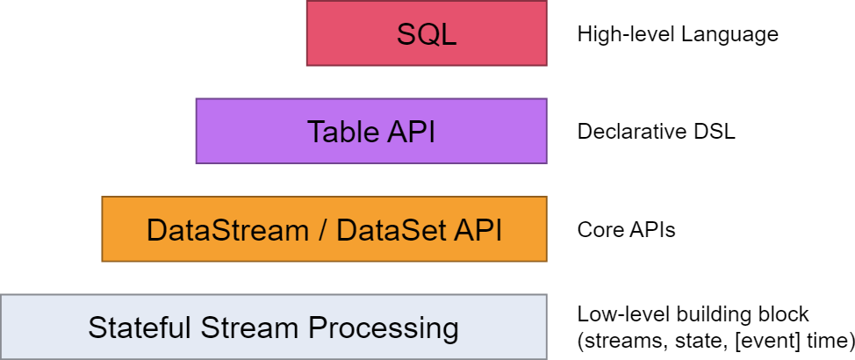
What is Apache Flink
Apache Flink is a framework and distributed processing engine for stateful computations over unbounded and bounded data streams. Flink has been designed to run in all common cluster environments, perform computations at in-memory speed, and at any scale. Developers build applications for Flink using APIs such as Java or SQL, which are executed on a Flink cluster by the framework.
Apache Flink reduces the complexity that has been faced by other distributed data-driven engines. It achieves this feature by integrating query optimization, concepts from database systems and efficient parallel in-memory and out-of-core algorithms, with the MapReduce framework.
https://flink.apache.org/

Slide 10
Apache Flink Features
True Streaming engine
Exactly-once guarantees
Low latency
High throughput
Powerful computation model
Low overhead
Flow control
Custom Memory Manager
Native closed-loop iteration operators
Automatic cost-based optimizer
Ease to use
Unified Framework
Etc.

Slide 11
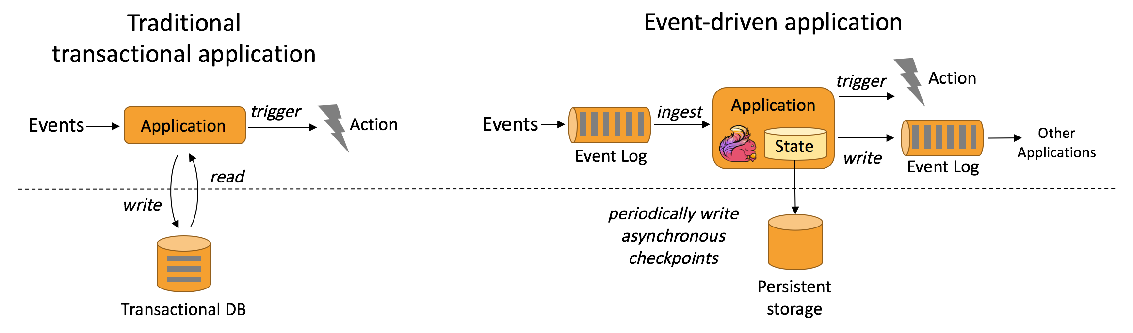
Use Cases - Event-driven Applications
Event-driven Applications: An event-driven application is a stateful application that ingest events from one or more event streams and reacts to incoming events by triggering computations, state updates, or external actions.Event-driven applications are an evolution of the traditional application design with separated compute and data storage tiers. In this architecture, applications read data from and persist data to a remote transactional database.
Fraud detection
Anomaly detection
Rule-based alerting
Business process monitoring
Web application (social network)

Slide 12
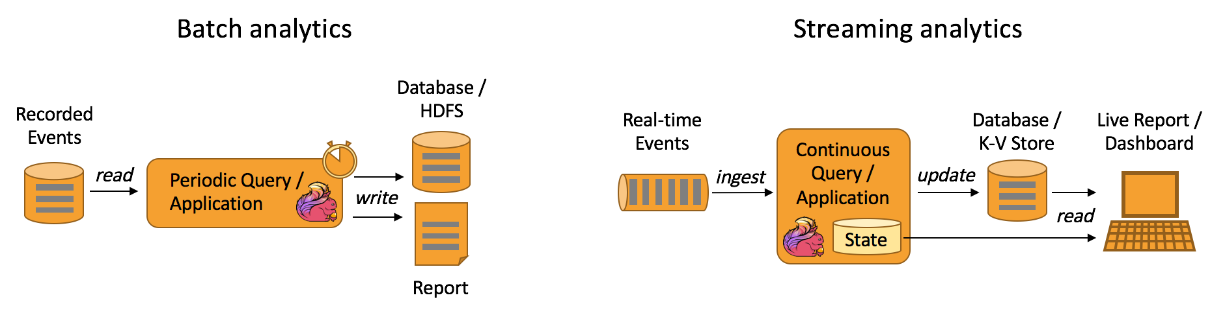
Use Cases - Data Analytics Applications
Data Analytics Applications: Analytical jobs extract information and insight from raw data. Traditionally, analytics are performed as batch queries or applications on bounded data sets of recorded events. In order to incorporate the latest data into the result of the analysis, it has to be added to the analyzed data set and the query or application is rerun. The results are written to a storage system or emitted as reports.With a stream processing engine, analytics can also be performed in a real-time fashion. Instead of reading finite data sets, streaming queries or applications ingest real-time event streams and continuously produce and update results as events are consumed. The results are either written to an external database or maintained as internal state. Dashboard application can read the latest results from the external database or directly query the internal state of the application.
Quality monitoring of Telco networks
Analysis of product updates & experiment evaluation in mobile applications
Ad-hoc analysis of live data in consumer technology
Large-scale graph analysis

Slide 13
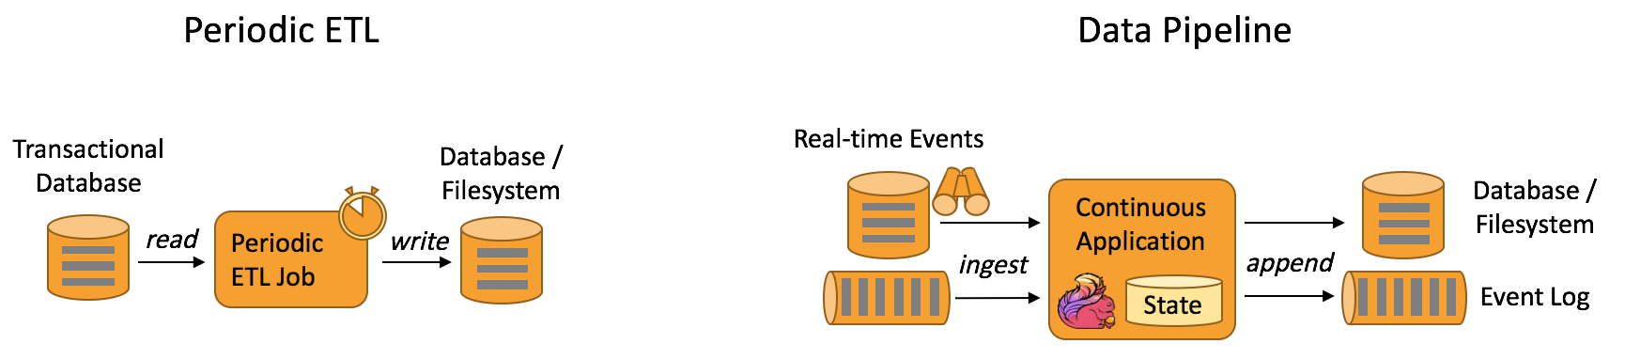
Use Cases - Data Pipeline Applications
Data Pipeline Applications: Extract-transform-load (ETL) is a common approach to convert and move data between storage systems. Often ETL jobs are periodically triggered to copy data from transactional database systems to an analytical database or a data warehouse.Data pipelines serve a similar purpose as ETL jobs. They transform and enrich data and can move it from one storage system to another. However, they operate in a continuous streaming mode instead of being periodically triggered. Hence, they are able to read records from sources that continuously produce data and move it with low latency to their destination.
Real-time search index building in e-commerce
Continuous ETL in e-commerce

Slide 14
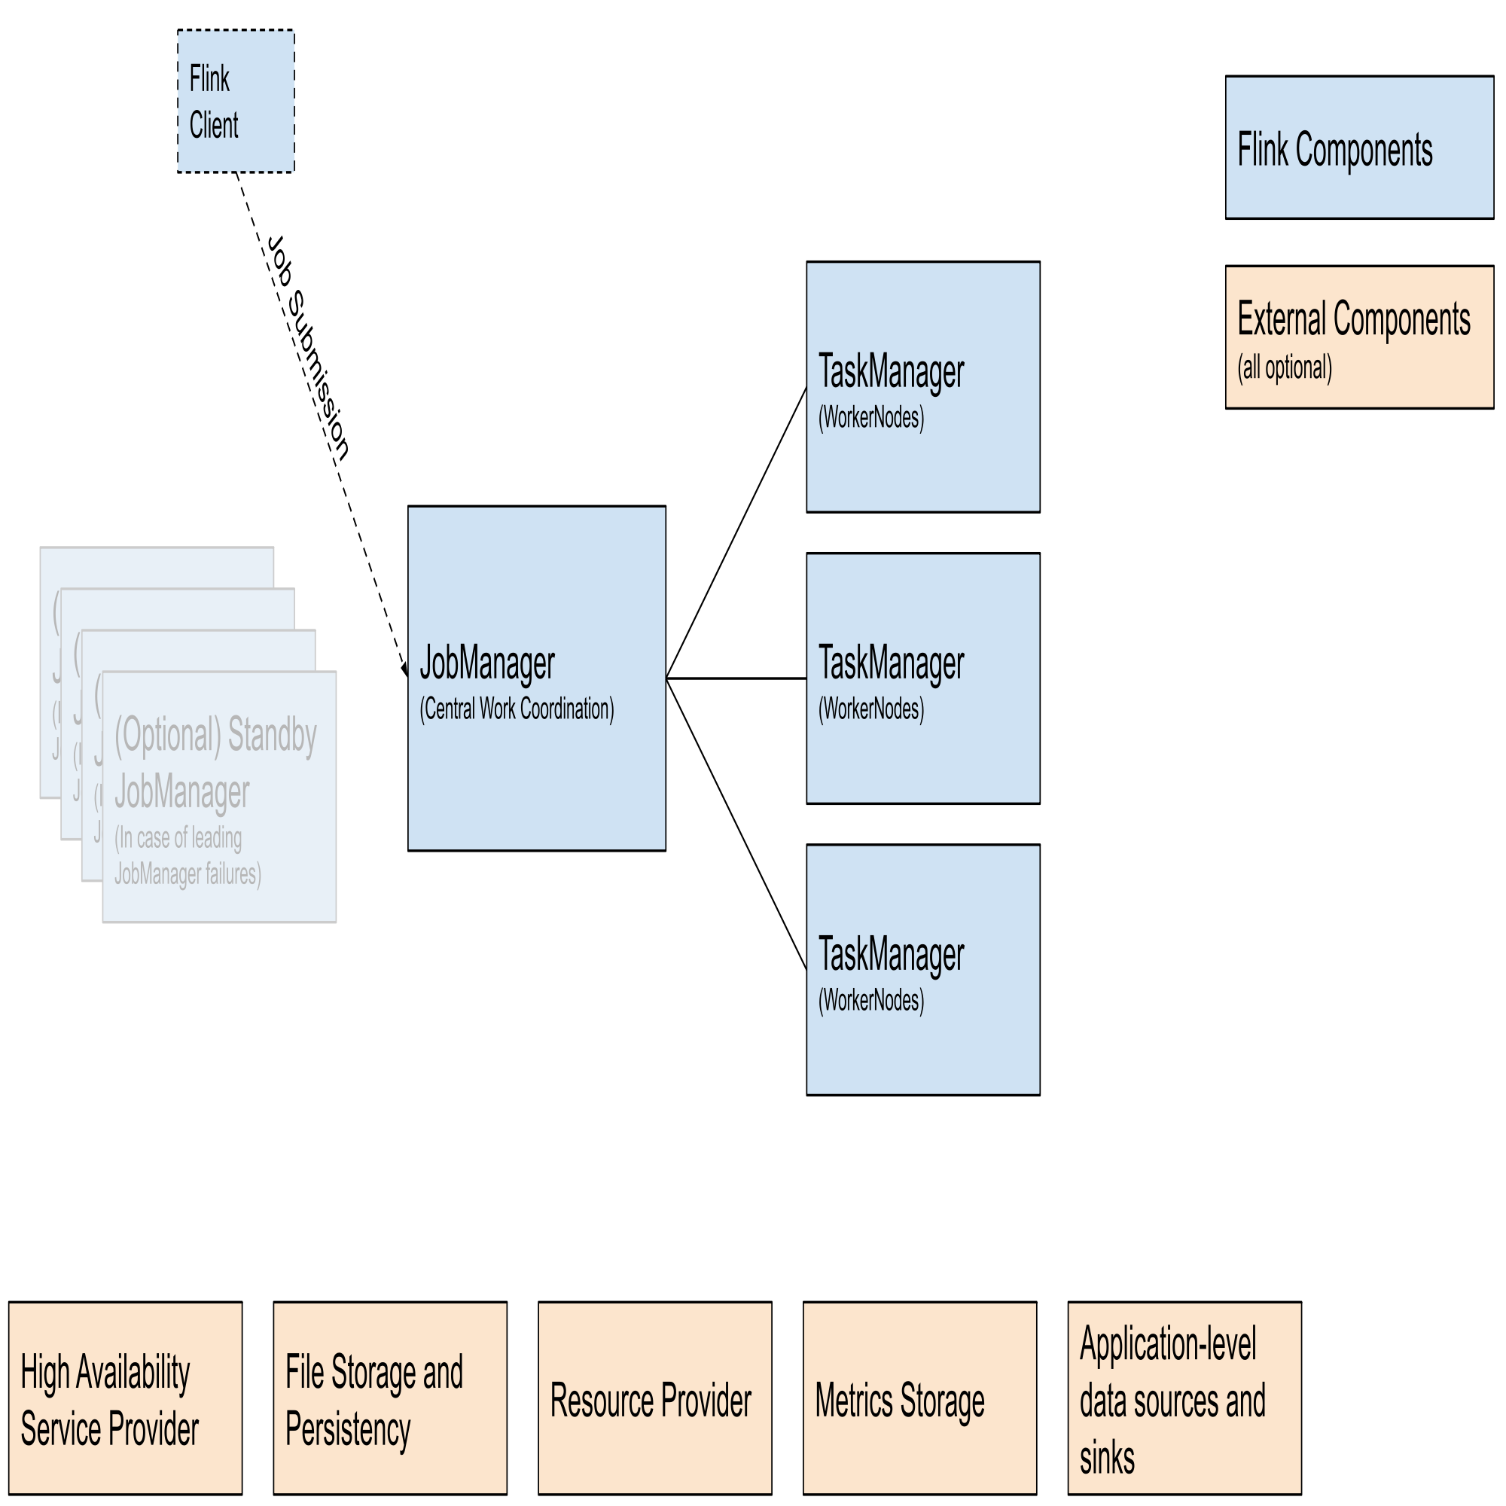
Overview Apache Flink Architecture
Flink Client: Compiles batch or streaming applications into a dataflow graph, which it then submits to the JobManager
JobManager: JobManager is the name of the central work coordination component of Flink. It has implementations for different resource providers, which differ on high-availability, resource allocation behavior and supported job submission modes.
Application Mode
Per-Job Mode
Session Mode
Task Manager: TaskManagers are the services actually performing the work of a Flink job.

Slide 15
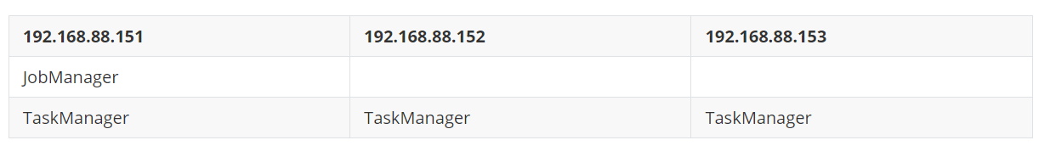
Apache Flink Standalone Cluster Install
Hosts and roles:
192.168.88.151
JobManager
TaskManager
192.168.88.152
TaskManager
192.168.88.153
TaskManager
Download apache flinke latest archive package
wget https://dlcdn.apache.org/flink/flink-1.17.2/flink-1.17.2-bin-scala_2.12.tgz --no-check-certificate
Install Apache Flink into destination directory
sudo tar -xzvf flink-1.17.2-bin-scala_2.12.tgz -C /opt
Create softlink
sudo ln -svnf flink-1.17.2 flink
Change the group and owner
sudo chown -hR hadoop:hadoop flink-1.17.2 flink

Slide 16
Standalone Cluster Configuration
flink-conf.yaml
jobmanager.rpc.address: hadoop151
jobmanager.rpc.port: 6123
jobmanager.bind-host: 0.0.0.0
jobmanager.memory.process.size: 1600m
taskmanager.bind-host: 0.0.0.0
taskmanager.host: hadoop151
taskmanager.memory.process.size: 1728m
taskmanager.numberOfTaskSlots: 2
parallelism.default: 1
jobmanager.execution.failover-strategy: region
rest.address: hadoop151
rest.bind-address: 0.0.0.0
master
hadoop151:8081
workers
hadoop151
hadoop152
hadoop153

Slide 17
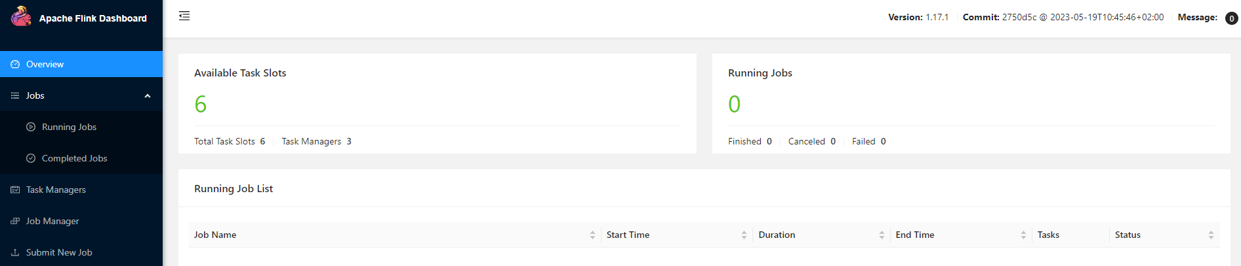
Start Flink Standalone Cluster
start flink standalone cluster ./start-cluster.sh
Starting cluster.
Starting standalonesession daemon on host hadoop151.
Starting taskexecutor daemon on host hadoop151.
Starting taskexecutor daemon on host hadoop152.
Starting taskexecutor daemon on host hadoop153.
http://hadoop151:8081/#/overview

Slide 18
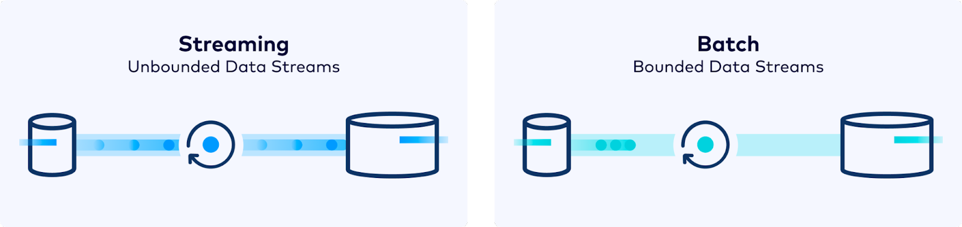
Apache Flink Application Development-I
The DataStream API gets its name from the special `DataStream` class that is used to represent a collection of data in a Flink program. You can think of them as immutable collections of data that can contain duplicates. This data can either be bounded or unbounded, the API that you use to work on them is the same.
Apache Flink’s unified approach to stream and batch processing means that a DataStream application executed over bounded input will produce the same *final* results, It is important to note what *final* means here: a job executing in `STREAMING` mode might produce incremental updates. while a `BATCH` job would only produce one final result at the end.

Slide 19
Apache Flink Application Development-II
Create Maven Project
DataSet API process batch data
DataStream API process batch data
DataStream API and Java 8 Lambda Expression
Submit flink application job at standalone cluster
Cancel flink application job

Slide 20
02
Flink Application Deploy Mode

Slide 21
Flink Application Deploy Mode
Flink Deployment Modes
Resource Provider
Standalone Resource Provider
Yarn Resource Provider
Session Mode
Per-Job Mode
Application Mode
Flink Standalone
YARN
Native Kubernetes
Session Mode
Application Mode
Session Mode
Per-Job Mode
Application Mode
Flink Job History Server

Slide 22
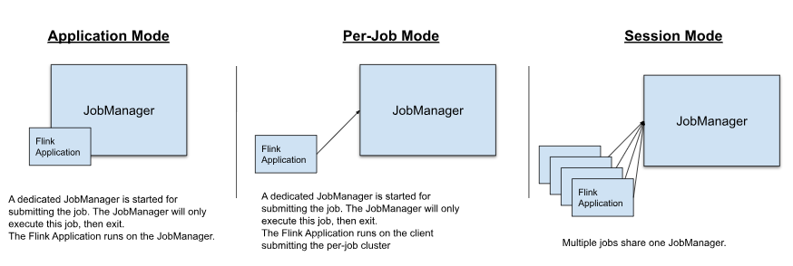
Flink Deployment modes
Flink can execute applications in one of three ways:
in Application Mode,
in Session Mode,
in a Per-Job Mode (deprecated).
Those three modes are differ in two aspects.
the cluster lifecycle and resource isolation guarantees
whether the application’s main() method is executed on the client or on the cluster.

Slide 23
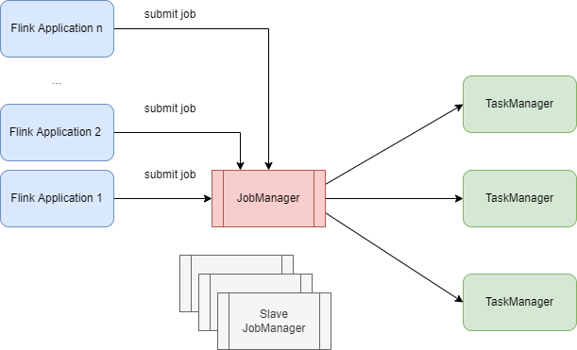
Session Mode
Session mode assumes an already running cluster and uses the resources of that cluster to execute any submitted application. Applications executed in the same (session) cluster use, and consequently compete for, the same resources.
Advantage
easy to undersdand
easy to setup
Job Manager role are unique in flink cluster
Disadvantage
Lack of resources isolation
Tasks affect each other in the same taskmanger
Cluster resources fixation
The jobmanager overresponsibility
Appropriate Scene
The job that Short execution time
Small job
Dev and Test

Slide 24
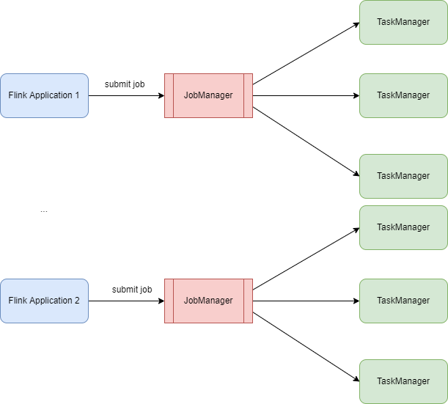
Per Job Mode
In a Flink Job Cluster, the available cluster manager (like YARN) is used to spin up a cluster for each submitted job and this cluster is available to that job only.
Advantage
better resource isolation
a misbehaving job can only bring down its own TaskManagers
Disadvantage
Flink Standalone Cluster not support
Flink client node overresponsibility
Apache flink deprecated this mode since Flink 1.15 version

Slide 25
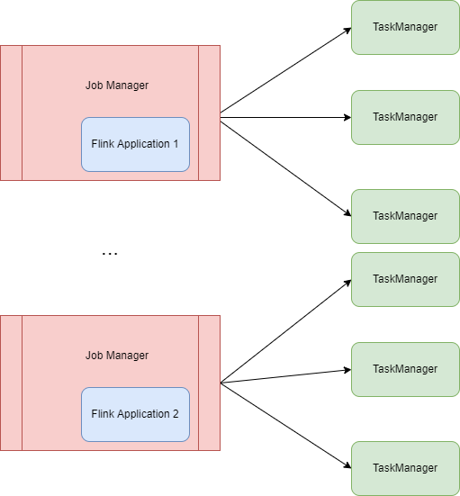
Application Mode
A Flink Application Cluster is a dedicated Flink cluster that only executes jobs from one Flink Application and where the `main()` method runs on the cluster rather than the client.
Advantage
better resource isolation
a misbehaving job can only bring down its own TaskManagers
Recommendation mode
Disadvantage
Flink Standalone Cluster support not good

Slide 26
Flink Deployment Mode Summary
In Session Mode, the cluster lifecycle is independent of that of any job running on the cluster and the resources are shared across all jobs.
Per-job mode is only supported by YARN and has been deprecated in Flink 1.15
Application Mode creates a session cluster per application and executes the application’s main() method on the cluster. It thus comes with better resource isolation as the resources are only used by the job(s) launched from a single main() method. This comes at the price of spining up a dedicated cluster for each application.

Slide 27



Resource Provider
Flink can be deployed through different Resource Provider Frameworks, such as Kubernetes or YARN.

Slide 28
Standalone Resource Provider
The standalone mode is the most barebone way of deploying Flink: The Flink services described in the deployment overview are just launched as processes on the operating system.
Unlike deploying Flink with a resource provider such as Kubernetes or YARN, you have to take care of restarting failed processes, or allocation and de-allocation of resources during operation.
Flink Standalone Resource Provider support 2 deployment modes
Session Mode
Application Mode(not good under standalone resource provider)
Standalone Session Mode
1. start flink cluster
2. make sure StandaloneSessionClusterEntrypoint process running
3. submit the flink job at console
Note: standalone mode will reject job submit once solts insufficient resources
Standalone Application Mode
1. No need start flink cluster
2. Located the flink application jar into $FLINK_HOME/lib
3. launch the JobManager by standalone-job.sh
4. according resources requirements start task manager

Slide 29
Hadoop Yarn Resource Provider
Apache Hadoop YARN is a resource provider popular with many data processing frameworks. Flink services are submitted to YARN’s ResourceManager, which spawns containers on machines managed by YARN NodeManagers. Flink deploys its JobManager and TaskManager instances into such containers.
Flink can dynamically allocate and de-allocate TaskManager resources depending on the number of processing slots required by the job(s) running on the JobManager.
Preparation
lunch a hadoop cluster
hadoop classpath
Resources
NameNode: http://hadoop151:9870/
ResourceManager: http://hadoop152:8088/cluster
Yarn Job History Server: http://hadoop153:19888/jobhistory/

Slide 30
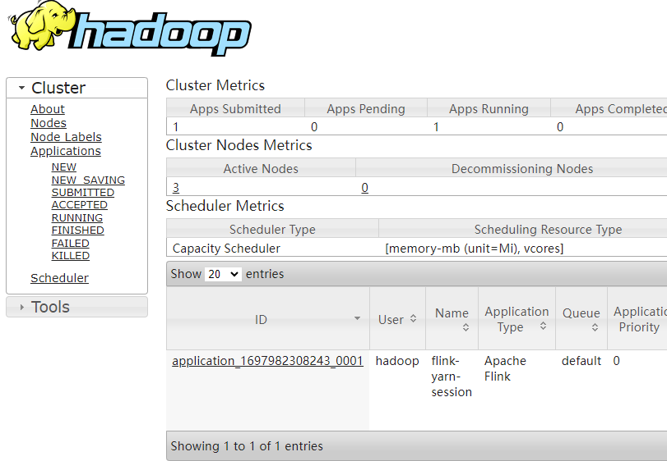
Yarn Resource Provider-Session Mode
In yarn session mode, Flink starts a cluster with only one Job Manager service in the cluster. When a job is submitted, the JobManager applies for resources from the Yarn ResourceManager based on the required resources and starts the TaskManager container.
Yarn Session Mode Steps:
bin/yarn-session.sh -d --name flink-yarn-session
bin/flink run -d -c com.alexwang.flink.chapter01.WordCountSocketStreamLambdaProcess -p 2 ./flink-learning-1.0-SNAPSHOT.jar
echo "stop" | ./bin/yarn-session.sh -id application_1697982308243_0001

Slide 31
Yarn Resource Provider-Per-Job Mode
Flink on YARN supports the Per Job mode in which one job is submitted at a time and resources are released after the job is completed.
A client submits a YARN application, such as a JobGraph or a JAR package.
The YARN ResourceManager applies for the first container. This container starts a process through the ApplicationMaster, which runs Flink programs, namely, the Flink YARN ResourceManager and JobManager.
The Flink YARN ResourceManager applies for resources from the YARN ResourceManager. The TaskManager is started after resources are allocated. After startup, the TaskManager registers with the Flink YARN ResourceManager. After registration, the JobManager allocates tasks to the TaskManager for execution.
Yarn Per-Job Mode Steps:
bin/flink run -t yarn-per-job -d -c com.alexwang.flink.chapter01.WordCountSocketStreamLambdaProcess ./flink-learning-1.0-SNAPSHOT.jar
./bin/flink cancel -t yarn-per-job -Dyarn.application.id=application_1697982308243_0002 a1a26a378bc37dcf81523b504ecfc792

Slide 32
Yarn Resource Provider-Application Mode
Application Mode creates a session cluster per application and executes the application’s main() method on the cluster. It thus comes with better resource isolation as the resources are only used by the job(s) launched from a single main() method
In all the other modes, the application’s main() method is executed on the client side. This process includes downloading the application’s dependencies locally, executing the main() to extract a representation of the application that Flink’s runtime can understand (i.e. the JobGraph) and ship the dependencies and the JobGraph(s) to the cluster.
Application Mode will launch a Flink cluster on YARN, where the main() method of the application jar gets executed on the JobManager in YARN not client side.
Yarn Application Mode Steps:
./bin/flink run-application -t yarn-application -c com.alexwang.flink.chapter01.WordCountSocketStreamLambdaProcess ./flink-learning-1.0-SNAPSHOT.jar -p 2 -d
./bin/flink cancel -t yarn-application -Dyarn.application.id=application_1697982308243_0002 a1a26a378bc37dcf81523b504ecfc792

Slide 33
Yarn Application Mode Best Practice
To unlock the full potential of the application mode, consider using it with the yarn.provided.lib.dirs configuration option and pre-upload your application jar to a location accessible by all nodes in your cluster.
that will allow the job submission to be extra lightweight as the needed Flink jars and the application jar are going to be picked up by the specified remote locations rather than be shipped to the cluster by the client.
Best Practice Steps:
hdfs dfs -mkdir /flink-dist
hdfs dfs -mkdir /flink-apps
hdfs dfs -put $FLINK_HOME/lib /flink-dist
hdfs dfs -put $FLINK_HOME/plugins /flink-dist
hdfs dfs -put flink-learning-1.0-SNAPSHOT.jar /flink-apps
./bin/flink run-application -t yarn-application -Dyarn.provided.lib.dirs="hdfs://hadoop151:8020/flink-dist" -c com.alexwang.flink.chapter01.WordCountSocketStreamLambdaProcess -p 2 -d hdfs://hadoop151:8020/flink-apps/flink-learning-1.0-SNAPSHOT.jar

Slide 34
Flink Job History Server
Flink has a history server that can be used to query the statistics of completed jobs after the corresponding Flink cluster has been shut down.
Hadoop Side
1. hdfs dfs -mkdir -p /flink-logs/flink-jobs
Flink-Conf.yaml Side
jobmanager.archive.fs.dir: hdfs://hadoop151:8020/flink-logs/flink-jobs
historyserver.web.address: hadoop151
historyserver.web.port: 8082
historyserver.archive.fs.dir: hdfs://hadoop151:8020/flink-logs/flink-jobs
historyserver.archive.fs.refresh-interval: 30000
classloader.check-leaked-classloader: false
Start Flink Job History Server
bin/historyserver.sh start
bin/historyserver.sh stop

Slide 35
03
Flink Runtime Architecture & Parallelism

Slide 36
Flink Runtime Architecture & Parallelism
Flink Runtime Architecture
Parallelism and Task Slots
Operator Chain
Inside Flink Job workflow
High Level Architecture
Inside Flink Components
How to configure
Slots and tasks
Parallelism
What is Operator Chain
Operator Chain API
SharedGroup
Flink Job workflow
Flink Job Graphs
Flink Job Graphs converations

Slide 37
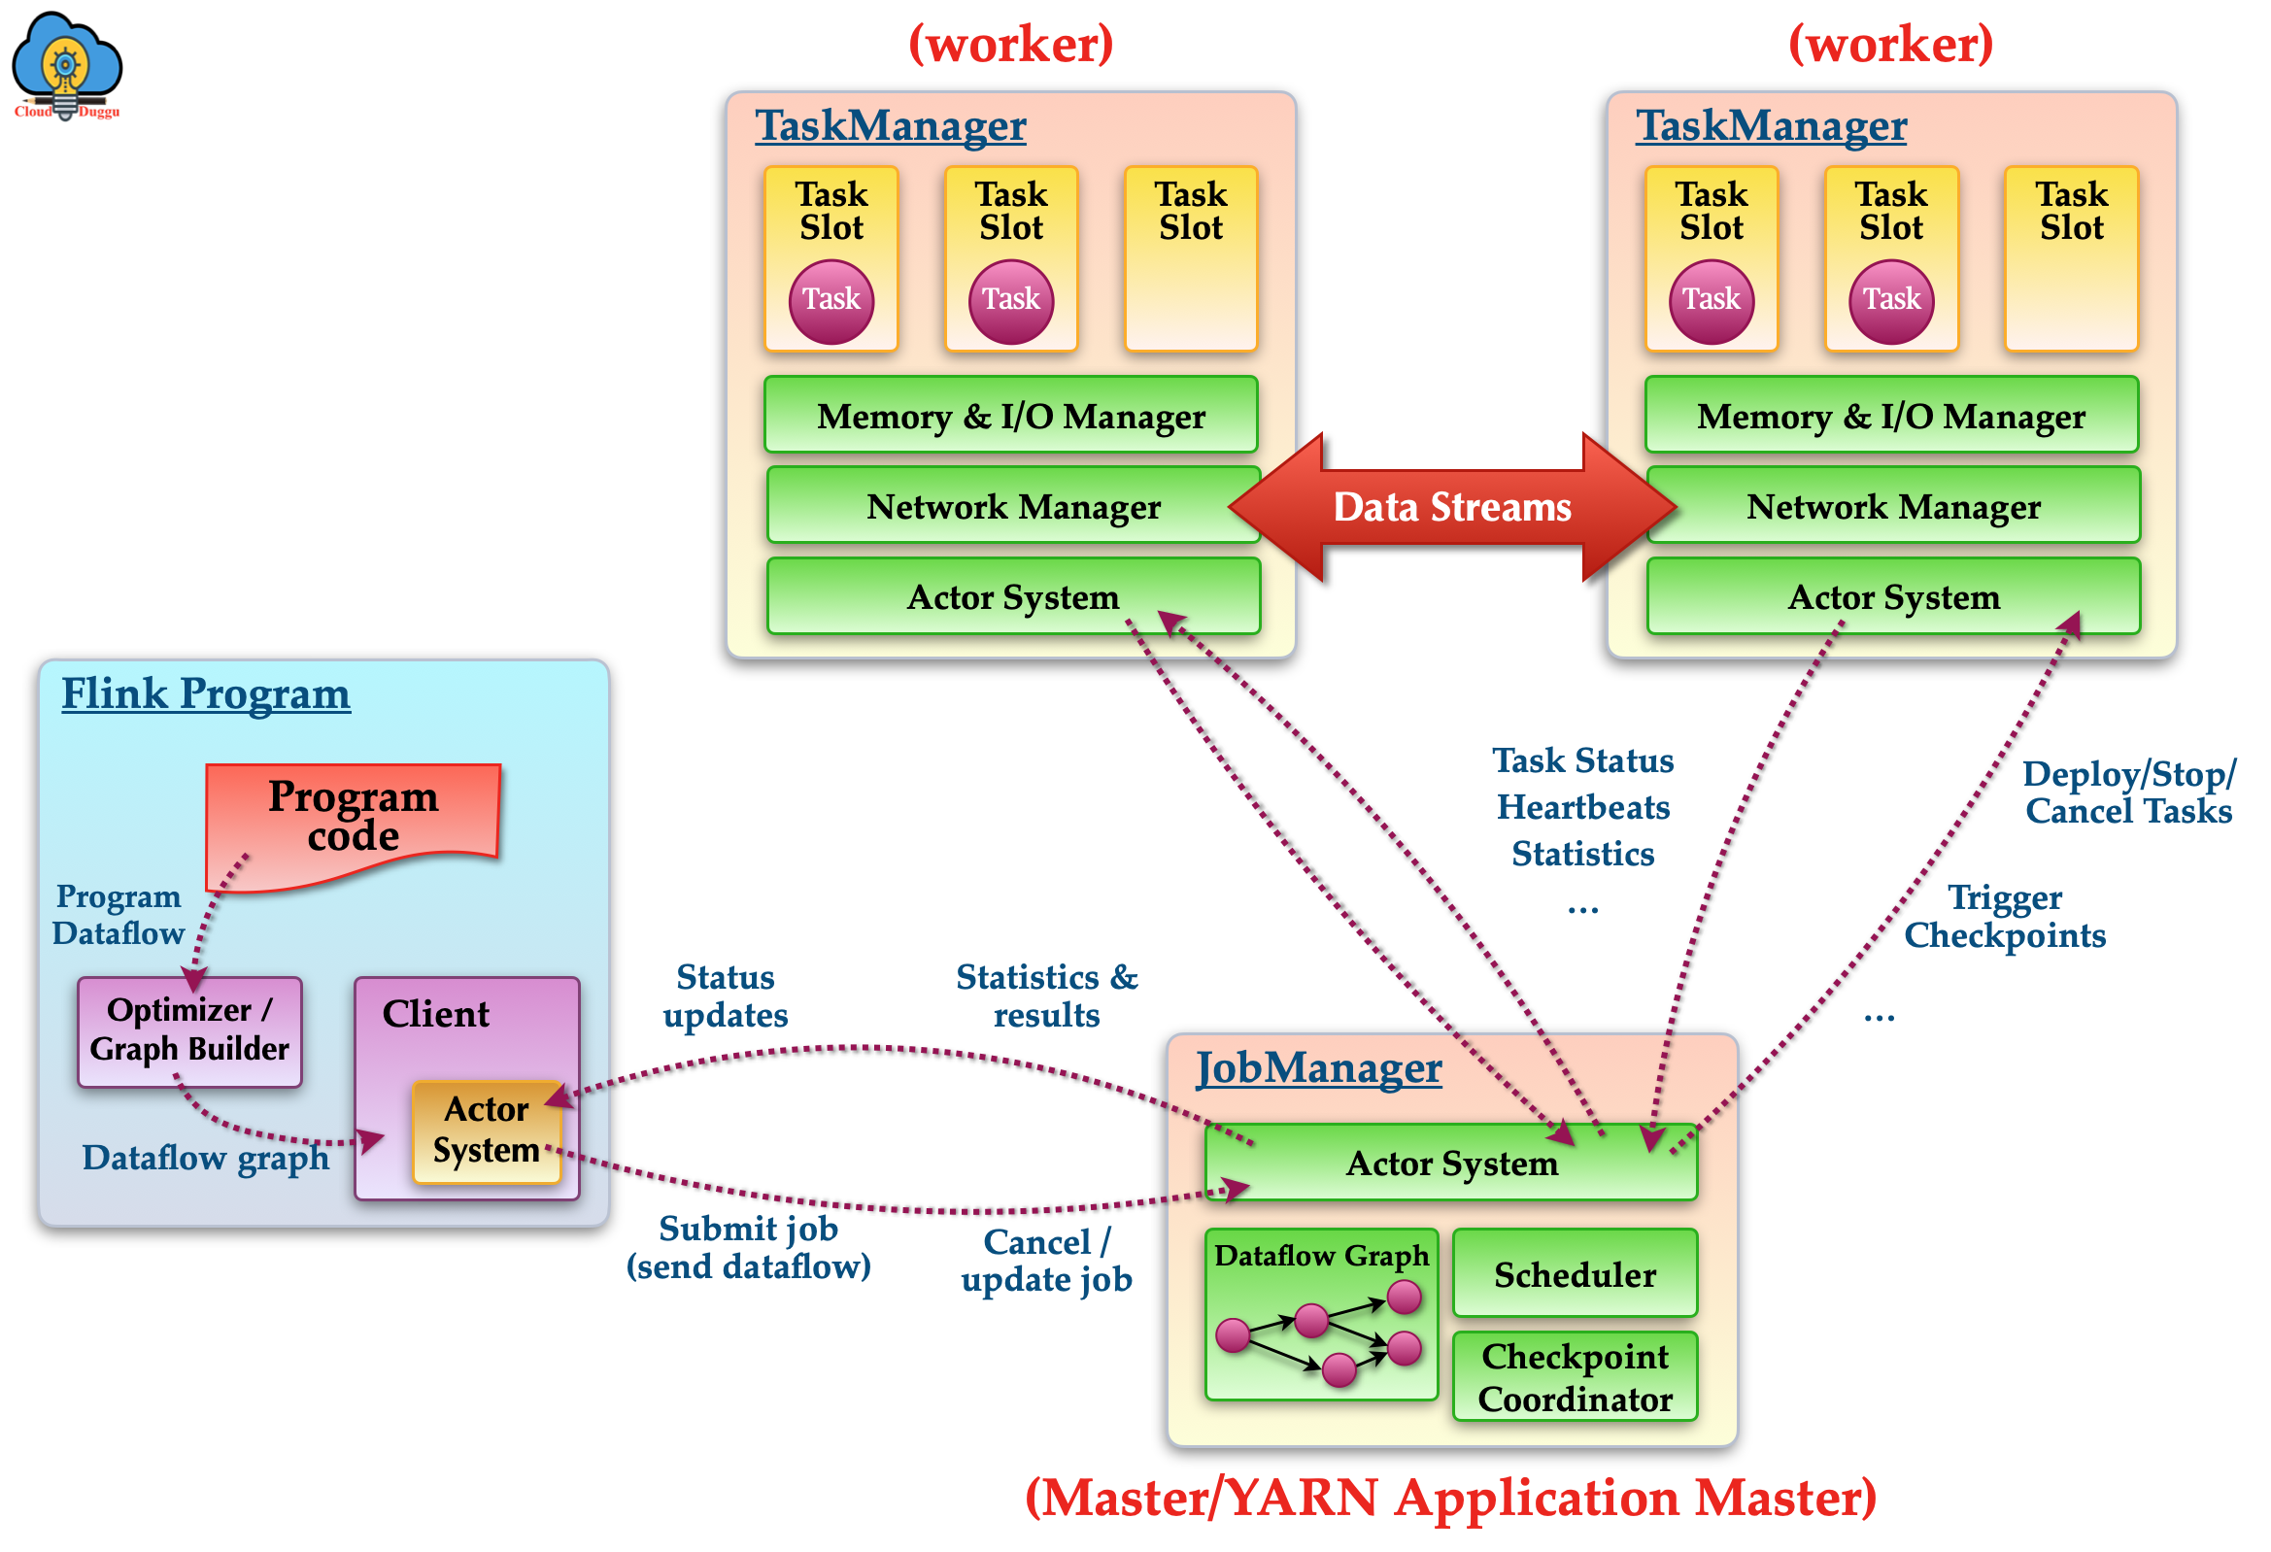
Flink Runtime Architecture
Apache Flink is a distributed stream processing system that works on Master - Slaves fashion. The Master serves a Manager node whereas Slaves servers as worker nodes. The master receives the request from the client and assigns it to slave nodes for further processing. The Slave Nodes work on those assigned tasks and update to the Master node.
The Flink runtime consists of two types of processes: a JobManager and one or more TaskManagers.
The Job Manager daemons run on the Master node of the cluster and work as a coordinator in the Flink system. It receives the program code from the client system and assigns that task to slave nodes for further processing.
The Task Manager demons run on the Slave nodes of the cluster and perform the actual operation in the Flink system. It receives the command from the Job Manager and performs the required action.

Slide 38

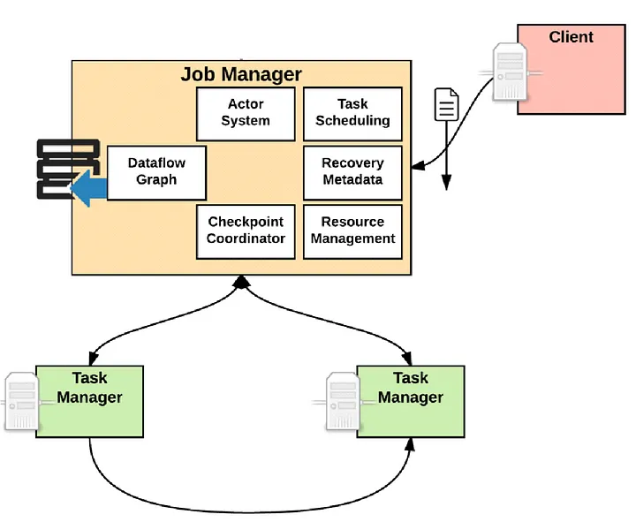
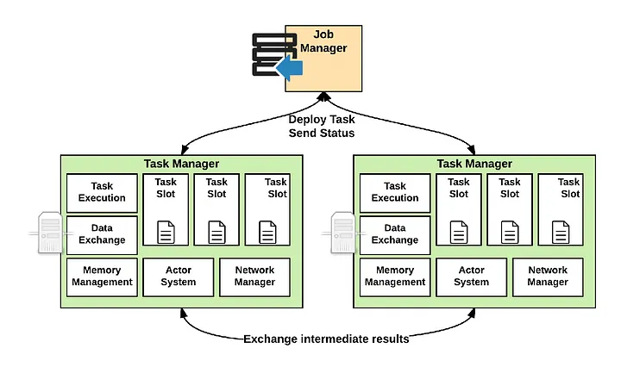
Flink Architecture Components
Flink Client
The Client is not part of the runtime and program execution, but is used to prepare and send a dataflow to the JobManager.
After that, the client can disconnect (detached mode), or stay connected to receive progress reports (attached mode).
Job Manager
ResourceManager:The ResourceManager is responsible for resource de-/allocation and provisioning in a Flink cluster — it manages task slots, which are the unit of resource scheduling in a Flink cluster
Dispatcher: The Dispatcher provides a REST interface to submit Flink applications for execution and starts a new JobMaster for each submitted job. It also runs the Flink WebUI to provide information about job executions.
JobMaster : A JobMaster is responsible for managing the execution of a single JobGraph. Multiple jobs can run simultaneously in a Flink cluster, each having its own JobMaster.
Task Manager
The TaskManagers(also called workers) execute the tasks of a dataflow, and buffer and exchange the data streams.There must always be at least one TaskManager.
Memory and I/O manager used to manage the memory I/O
Network Manager used to manage networks
Actor System used to implement network communication

Slide 39
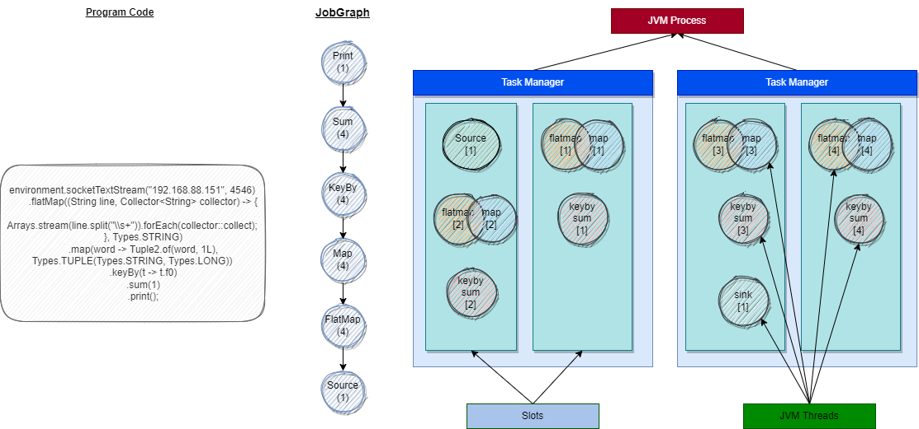
Task Execution
A TaskManager can execute several tasks at the same time. These tasks can be subtasks of the same operator (data parallelism), a different operator (task parallelism), or even from a different application (job parallelism). A TaskManager offers a certain number of processing slots to control the number of tasks it is able to concurrently execute.

Slide 40
Task & Slot & SubTask
Slot: About slots which are the unit of resource scheduling in a Flink cluster, Flink implements multiple ResourceManagers for different environments and resource providers such as YARN, Kubernetes and standalone deployments. In a standalone setup, the ResourceManager can only distribute the slots of available TaskManagers and cannot start new TaskManagers on its own. There must always be at least one TaskManager. The smallest unit of resource scheduling in a TaskManager is a task *slot*. The number of task slots in a TaskManager indicates the number of concurrent processing tasks.
Task: The Task represents one execution of a parallel subtask on a TaskManager. A Task wraps a Flink operator (which may be a user function) and runs it, providing all services necessary for example to consume input data, produce its results (intermediate result partitions) and communicate with the JobManager.
SubTask: A subtask is one parallel slice of a task. This is the schedulable, runable unit of execution.

Slide 41
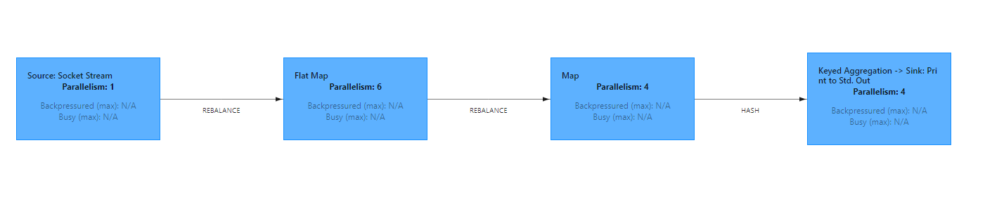
Parallel Execution
A Flink program consists of multiple tasks (transformations/operators, data sources, and sinks). A task is split into several parallel instances(subtask) for execution and each parallel instance(subtask) processes a subset of the task’s input data. The number of parallel instances(subtask) of a task is called its parallelism.
The maximum operator parallelism also is flink job maximum parallelism
There are 4 places can configure the flink application parallelism
ExecutionEnvironment
Operator
Flink submit job console option
flink-conf.yaml configuration
The parallelism priority: Operator > ExecutionEnvironment > Console Option > flink-conf.yaml configuration

Slide 42
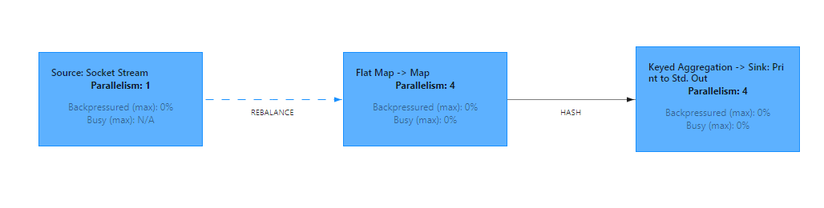
Operator Chain
For distributed execution, Flink chains operator subtasks together into tasks. Each task is executed by one thread. Chaining operators together into tasks is a useful optimization: it reduces the overhead of thread-to-thread handover and buffering, and increases overall throughput while decreasing latency.
Parallelism = 4

Slide 43
Operator Chain Illustration
Source
flatmap
map
keyby
sum
sink
Job Graph
Parallelism = 2
Source
[1]
flatmap
[1]
map
[1]
keyby
sum
[1]
sink
[1]
Job Parallel Graph
Source
[2]
flatmap
[2]
map
[2]
keyby
sum
[2]
sink
[2]
Source
[1]
flatmap
[1]
map
[1]
keyby
sum
[1]
sink
[1]
Job Execution Graph
(Chaining)
Source
[2]
flatmap
[2]
map
[2]
keyby
sum
[2]
sink
[2]

Slide 44
Question 1: SubTasks Distributing
Slots
Slots
Slots
source
[1]
flatmap
[1]
map
[1]
keyby
sum
[1]
sink
[1]
source
[1]
flatmap
[1]
map
[1]
source
[2]
flatmap
[2]
map
[2]
source
[2]
flatmap
[2]
map
[2]
source
[1]
flatmap
[1]
map
[1]
source
[2]
flatmap
[2]
map
[2]
keyby
sum
[2]
sink
[2]
keyby
sum
[1]
sink
[1]
keyby
sum
[2]
sink
[2]
keyby
sum
[2]
sink
[2]
keyby
sum
[1]
sink
[1]
TaskManager
TaskManager
TaskManager
×
√
√
Flink only allows subtasks to share slots that they are subtasks of different tasks

Slide 45
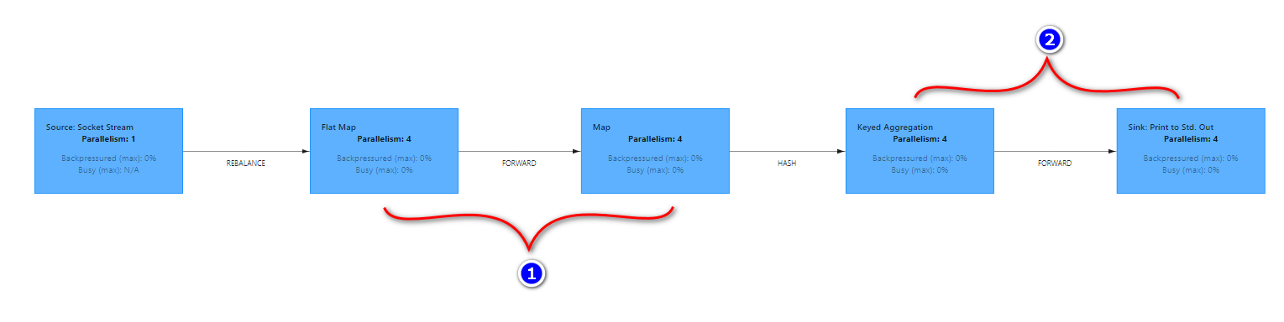
The occurrence of Operator Chaining
Operator Chaining is the default behavior of Flink and is designed to optimize the execution of a job, it reduces the overhead of thread-to-thread handover and buffering.
When does operator chaining occur?
operators have the same parallelism
operators grouped into the same slot group
operators connected by forward channels.

Slide 46
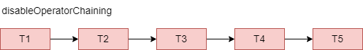
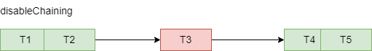
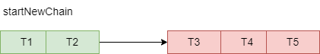
Operator Chaining API
disableOperatorChaining: Disables operator chaining for streaming operators. this is the global control method at StreamExecutionEnvironment.
disableChaining: Turns off chaining for this operator so thread co-location will not be used as an optimization.
startNewChain: Start new chaining begin this operator

Slide 47

Slots Group
A Flink job maximum operator parallelism is 2, How many available slots can support this Flink job running up?
Set the slot sharing group of an operation. Flink will put operations with the same slot sharing group into the same slot while keeping operations that don’t have the slot sharing group in other slots. This can be used to isolate slots. The slot sharing group is inherited from input operations if all input operations are in the same slot sharing group. The name of the default slot sharing group is “default”, operations can explicitly be put into this group by calling slotSharingGroup(“default”).

Slide 48
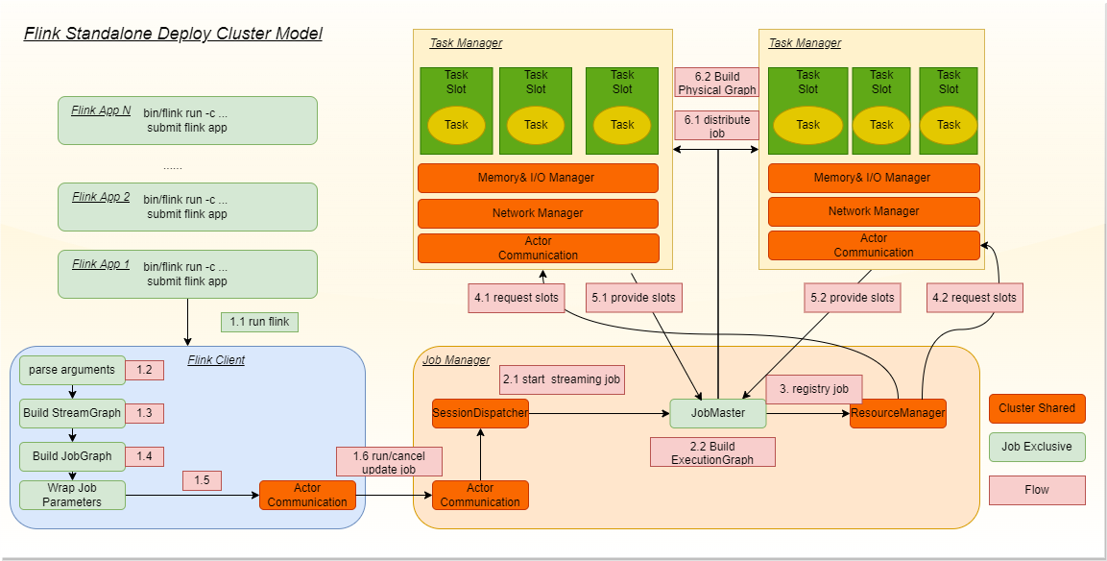
Standalone Flink Job Execution workflow
On submitting a JobGraph to the master node through a Flink cluster client, the JobGraph is first forwarded through the Dispatcher
After receiving a request from the client, the Dispatcher generates a JobMaster. The JobMaster applies for resources from the Standalone ResourceManager.
Standalone ResourceManager requests available slots from cluster TaskManager
TaskManager provide free slots to JobMaster
JobMaster distribute Flink job execution graph to slots for job execution.

Slide 49
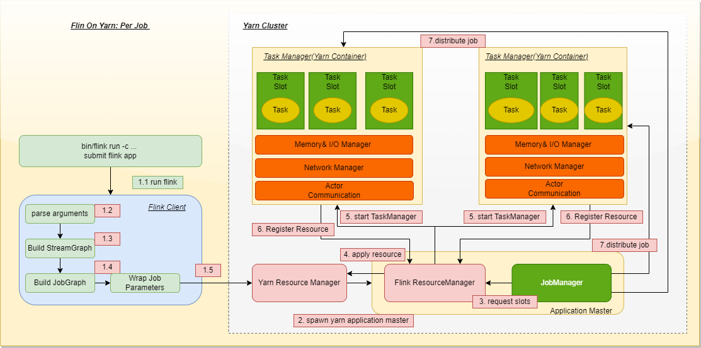
Flink on YARN Per-Job Execution workflow
A client submits a YARN application, such as a JobGraph or a JAR package.
The YARN ResourceManager applies for the first container. This container starts a process through the ApplicationMaster, which runs Flink programs, namely, the Flink YARN ResourceManager and JobManager.
The Flink YARN ResourceManager applies for resources from the YARN ResourceManager. The TaskManager is started after resources are allocated.
After startup, the TaskManager registers with the Flink YARN ResourceManager.
After registration, the JobManager allocates tasks to the TaskManager for execution.

Slide 50
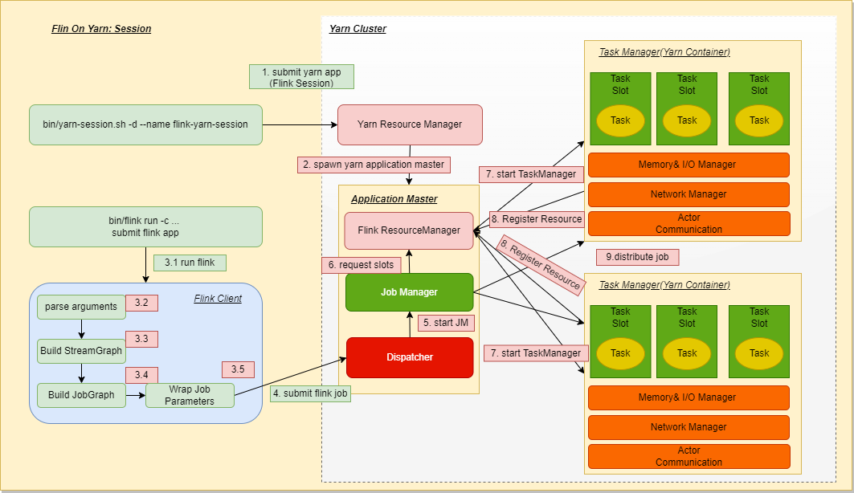
Flink on YARN Session Execution workflow
Start yarn session cluster
In Session mode, after receiving a request, the Dispatcher starts Job Manager, which starts the TaskManager.
The job manager of flink applies for resources from the yarn resource manager through the flink yarn resource manager.
According to the Job runtime requirements, start the TaskManager container.
at last the jobmanager distributed job tasks to TM for execution.

Slide 51
Dataflow Graphs
As the name suggests, a dataflow program describes how data flows between operations. Dataflow programs are commonly represented as directed graphs, where nodes are called operators and represent computations and edges represent data dependencies. Operators are the basic functional units of a dataflow application. They consume data from inputs, perform a computation on them, and produce data to outputs for further processing. Operators without input ports are called data sources and operators without output ports are called data sinks. A dataflow graph must have at least one data source and one data sink.

Slide 52
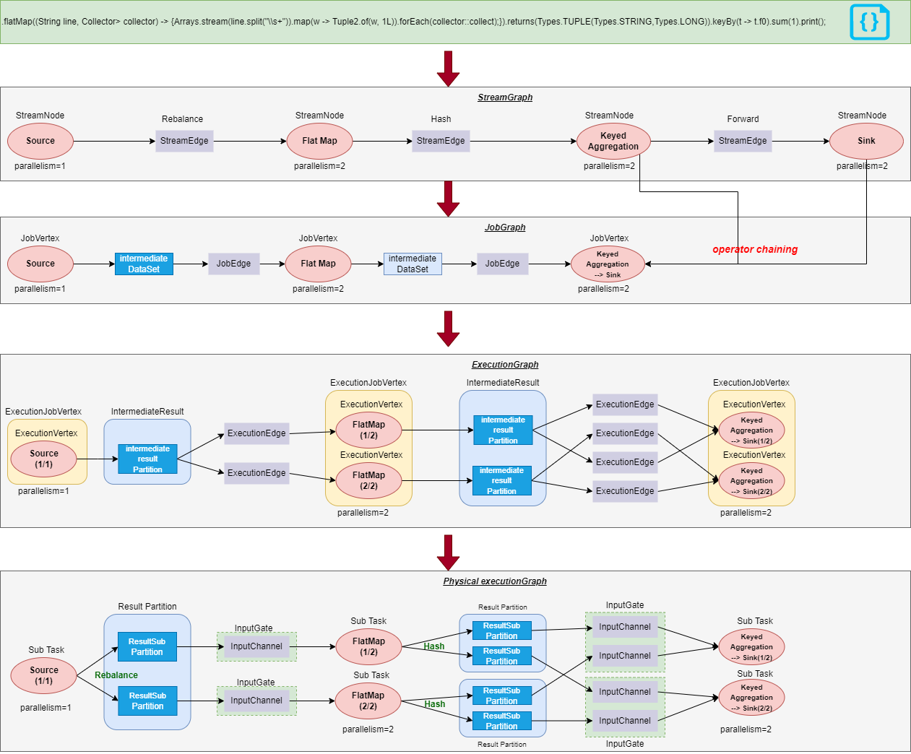
Flink Graphs Transformation
The first-level transformation from a program to a StreamGraph starts with source nodes. Each transform operation generates one StreamNode. Two StreamNodes are connected by a StreamEdge to form a DAG.
The second-level transformation from the StreamGraph to a JobGraph also starts with source nodes. Operators are traversed to find the operators that can be chained. If any operators cannot be chained, a separate JobVertex is created for each of them. Upstream and downstream JobVertexes are connected by a JobEdge to form a DAG at the JobVertex level.
After the JobVertex DAG is submitted to a task, nodes are sorted starting from source nodes. An ExecutionJobVertex is created based on each JobVertex, and an IntermediateResult is created based on the IntermediateDataSet of each JobVertex. The IntermediateResult is used to create an upstream-downstream dependency to form a DAG at the ExecutionJobVertex level, namely, the ExecutionGraph.
Finally, the ExecutionGraph is transformed into a physical execution plan.

Slide 53
04
Flink DataStream API and Program

Slide 54
Flink Data Stream API and Program
Source Connector
Stream Data Transformation
Data Redistributing
Sink Connector
Collections Source
DataGen Source
Socket Source
Local File Source
HDFS Source
Mongodb Source
Apache Kafka Source
Custom Source
map/flatmap
filtering
TypeInformation
keyby and grouping
aggregation
union
connect
SideOutput
shuffle
rebalance
forward
broadcast
hash(group)
rescale
global
custom StreamPartitioner
Socket Sink
Local File System Sink
HDFS Sink
JDBC Sink
Apache Kafka Sink
Mongodb Sink
Custom Sink

Slide 55
Flink Source Connector
A few basic data sources and sinks are built into Flink and are always available. The predefined data sources include reading from files, directories, and sockets, and ingesting data from collections and iterators. The predefined data sinks support writing to files, to stdout and stderr, and to sockets.
https://nightlies.apache.org/flink/flink-docs-release-1.17/docs/connectors/datastream/overview/
https://bahir.apache.org/docs/flink/current/documentation/
Java Collection Source
DataGeneratorSource
Socket Source
LocalFile Source
HdfsFile System Source
Mongodb Source
Apache Kafka topic Source
Customize Source

Slide 56
Java Collection Source Connector
fromCollection: Creates a data stream from the given non-empty collection. The type of the data stream is that of the elements in the collection.
fromElements: Creates a new data stream that contains the given elements. The elements must all be of the same type, for example, all of the String or Integer.
fromSequence: Creates a new data stream that contains a sequence of numbers (longs) and is useful for testing and for cases that just need a stream of N events of any kind. The generated source splits the sequence into as many parallel sub-sequences as there are parallel source readers. Each sub-sequence will be produced in order. If the parallelism is limited to one, the source will produce one sequence in order.

Slide 57
DataGen Source Connector
The DataGen connector provides a Source implementation that allows for generating input data for Flink pipelines. It is useful when developing locally or demoing without access to external systems such as Kafka.
The DataGeneratorSource produces N data points in parallel. The source splits the sequence into as many parallel sub-sequences as there are parallel source subtasks. It drives the data generation process by supplying “index” values of type Long to the user-provided GeneratorFunction .
This source is always bounded. From a practical perspective, however, setting the number of records to Long.MAX_VALUE turns it into an effectively unbounded source.
DataGeneratorSource has built-in support for rate limiting. The following code will produce a stream of Long values at the overall source rate (across all source subtasks) not exceeding 100 events per second.

Slide 58
FileSystem Connector
This connector provides a unified Source and Sink for BATCH and STREAMING that reads or writes (partitioned) files to file systems supported by the Flink FileSystem abstraction. This filesystem connector provides the same guarantees for both BATCH and STREAMING and is designed to provide exactly-once semantics for STREAMING execution.
The connector supports reading and writing a set of files from any (distributed) file system (e.g. POSIX, S3, HDFS) with a format (e.g., Avro, CSV, Parquet), and produces a stream or records.
A StreamFormat reader formats text lines from a file. The reader uses Java’s built-in InputStreamReader to decode the byte stream using various supported charset encodings. This format does not support optimized recovery from checkpoints. On recovery, it will re-read and discard the number of lines that were processed before the last checkpoint.
The BulkFormat reads and decodes batches of records at a time. Examples of bulk formats are formats like ORC or Parquet. The outer BulkFormat class acts mainly as a configuration holder and factory for the reader.

Slide 59
Custom Source Connector
Implement SourceFunction or RichSourceFunction with RuntimeContext.
Implement ParallelSourceFunction or RichParallelSourceFunction with RuntimeContext.
Flink new Source API

Slide 60
Flink Data Types and TypeInformation
Apache Flink handles data types and serialization in a unique way, containing its own type descriptors, generic type extraction, and type serialization framework.
The central class in Flink’s type system is TypeInformation. It provides the system with the necessary information it needs to generate serialiazers and comparators. For instance, when you join or group by some key, TypeInformation allows Flink to perform the semantic check of whether the fields used as keys are valid. When an application is submitted for execution, Flink’s type system tries to automatically derive the TypeInformation for every data type that is processed by the framework.
There are seven different categories of data types:
Java Tuples and Scala Case Classes: Tuples are composite types that contain a fixed number of fields with various types. The Java API provides classes from Tuple1 up to Tuple25
Java POJOs: Java and Scala classes are treated by Flink as a special POJO data type if they fulfill the following requirements: The class must be public, It must have a public constructor without arguments (default constructor). All fields are either public or must be accessible through getter and setter functions. The type of a field must be supported by a registered serializer.
Primitive Types: Flink supports all Java and Scala primitive types such as Integer, String, and Double
Regular Classes: Flink supports most Java and Scala classes (API and custom). Restrictions apply to classes containing fields that cannot be serialized, like file pointers, I/O streams, or other native resources. Classes that follow the Java Beans conventions work well in general. Flink treats these data types as black boxes and is not able to access their content (e.g., for efficient sorting). General types are de/serialized using the serialization framework Kryo.
Values: Value types describe their serialization and deserialization manually. Instead of going through a general purpose serialization framework, they provide custom code for those operations by means of implementing the org.apache.flink.types.Value interface with the methods read and write.
Hadoop Writables: You can use types that implement the org.apache.hadoop.Writable interface. The serialization logic defined in the write()and readFields() methods will be used for serialization.
Special Types: You can use special types, including Scala’s Either, Option, and Try. The Java API has its own custom implementation of Either. Similarly to Scala’s Either, it represents a value of two possible types, Left or Right. Either can be useful for error handling or operators that need to output two different types of records.

Slide 61
Stream data transformations
A stream transformation is applied on one or more streams and converts them into one or more output streams. Writing a DataStream API program essentially boils down to combining such transformations to create a dataflow graph that implements the application logic.
Most stream transformations are based on user-defined functions. The functions encapsulate the user application logic and define how the elements of the input stream are transformed into the elements of the output stream.
Most function interfaces are designed as SAM (single abstract method) interfaces and they can be implemented as Java 8 lambda functions. The Scala DataStream API also has built-in support for lambda functions.
The DataStream API provides transformations for the most common data transformation operations. We present the transformations of the DataStream API in four categories:
Basic transformations are transformations on individual events.
KeyedStream transformations are transformations that are applied to events in the context of a key.
Multistream transformations merge multiple streams into one stream or split one stream into multiple streams.
Distribution transformations reorganize stream events.

Slide 62
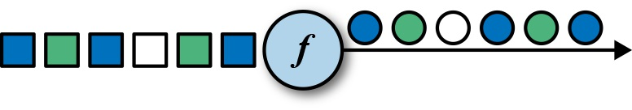
Basic Transformations-MAP
The map transformation is specified by calling the DataStream.map() method and produces a new DataStream. It passes each incoming event to a user-defined mapper that returns exactly one output event, possibly of a different type.
DataStream provide two overload method
map(MapFunction<T, R> mapper)
map( MapFunction<T, R> mapper, TypeInformation<R> outputType)

Slide 63
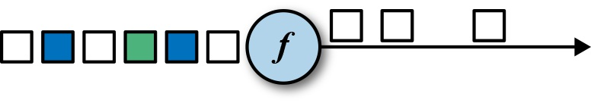
Basic Transformations-FILTER
The filter transformation drops or forwards events of a stream by evaluating a boolean condition on each input event. A return value of true keep the input event and forwards it to the output, and false results in dropping the event.
filter(FilterFunction<T> filter)

Slide 64
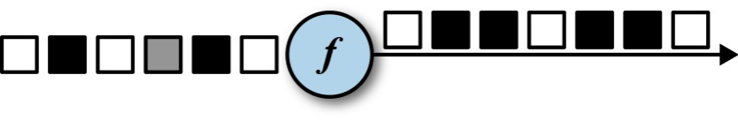
Basic Transformations-FLATMAP
The flatMap transformation is similar to map, but it can produce zero, one, or more output events for each incoming event. In fact, the flatMap transformation is a generalization of filter and map and can be used to implement both those operations.
DataStream provide two overload method
flatMap(FlatMapFunction<T, R> flatMapper)
flatMap(FlatMapFunction<T, R> flatMapper, TypeInformation<R> outputType)
Applies a FlatMap transformation on a DataStream. The transformation calls a FlatMapFunction for each element of the DataStream. Each FlatMapFunction call can return any number of elements including none.

Slide 65
KeyedStream
A common requirement of many applications is to process groups of events that share a certain property together. The DataStream API features the abstraction of a KeyedStream, which is a DataStream that has been logically partitioned into disjoint substreams of events.
A KeyedStream represents a DataStream on which operator state is partitioned by key using a provided KeySelector.
Stateful transformations that are applied on a KeyedStream read from and write to state in the context of the currently processed event’s key. This means that all events with the same key access the same state and thus can be processed together.

Slide 66
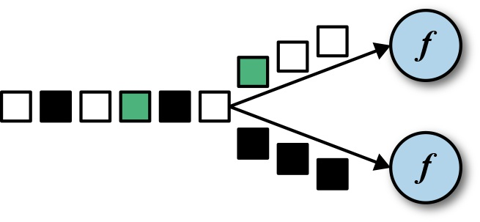
Converts a DataStream into a KeyedStream
The keyBy transformation converts a DataStream into a KeyedStream by specifying a key. Based on the key, the events of the stream are assigned to partitions, so that all events with the same key are processed by the same task of the subsequent operator. Events with different keys can be processed by the same task, but the keyed state of a task’s function is always accessed in the scope of the current event’s key.
Rolling aggregation transformations are applied on a KeyedStream and produce a DataStream of aggregates, such as sum, minimum, and maximum.
The reduce transformation is a generalization of the rolling aggregation. It applies a ReduceFunction on a KeyedStream, which combines each incoming event with the current reduced value, and produces a DataStream. A reduce transformation does not change the type of the stream. The type of the output stream is the same as the type of the input stream.

Slide 67
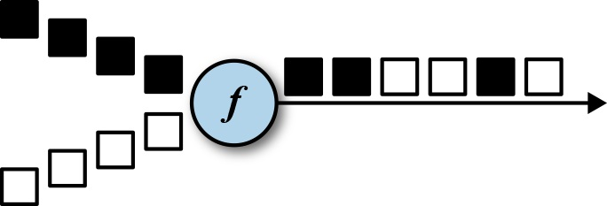
Multistream Transformations - UNION
The DataStream.union() method merges two or more DataStreams of the same type and produces a new DataStream of the same type.
The events are merged in a FIFO fashion—the operator does not produce a specific order of events. Moreover, the union operator does not perform duplication elimination. Every input event is emitted to the next operator.

Slide 68
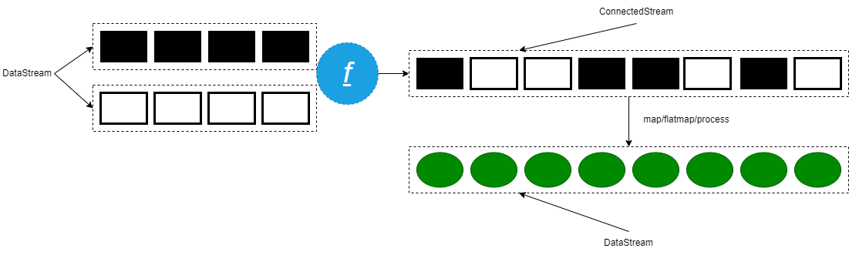
Multistream Transformations - CONNECT
Combining events of two streams is a very common requirement in stream processing. Consider an application that monitors a forest area and outputs an alert whenever there is a high risk of fire. The application receives the stream of temperature sensor readings you have seen previously and an additional stream of smoke level measurements. When the temperature is over a given threshold and the smoke level is high, the application emits a fire alert.
The DataStream API provides the connect transformation to support such use cases. The DataStream.connect() method receives a DataStream and returns a ConnectedStreams object.

Slide 69

Inner Join
SELECT a.id,a.name,b.address from USER as a inner join ADDRESS b on a.id=b.id;
Left join between two data streams
Left outer join between two data streams

Slide 70
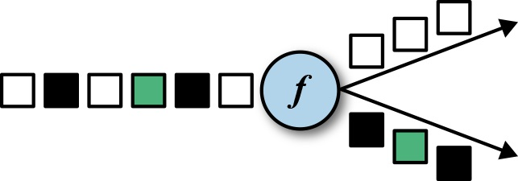
Side Output
In addition to the main stream that results from DataStream operations, you can also produce any number of additional side output result streams. The type of data in the result streams does not have to match the type of data in the main stream and the types of the different side outputs can also differ. This operation can be useful when you want to split a stream of data where you would normally have to replicate the stream and then filter out from each stream the data that you don’t want to have.
Emitting data to a side output is possible from the following functions:
ProcessFunction
KeyedProcessFunction
CoProcessFunction
KeyedCoProcessFunction
ProcessWindowFunction
ProcessAllWindowFunction

Slide 71
RichFunction
Oftentimes there is a need to initialize a function before it processes the first record or to retrieve information about the context in which it is executed. The DataStream API provides rich functions that expose more functionality than the regular functions discussed until now.
There are rich versions of all the DataStream API transformation functions, and you can use them in the same places you can use a regular function or lambda function. Rich functions can be parameterized just like regular function classes.
The name of a rich function starts with Rich followed by the transformation name —RichMapFunction, RichFlatMapFunction, and so on.
When using a rich function, you can implement two additional methods to the function’s lifecycle:
open()
close()
getRuntimeContext()

Slide 72
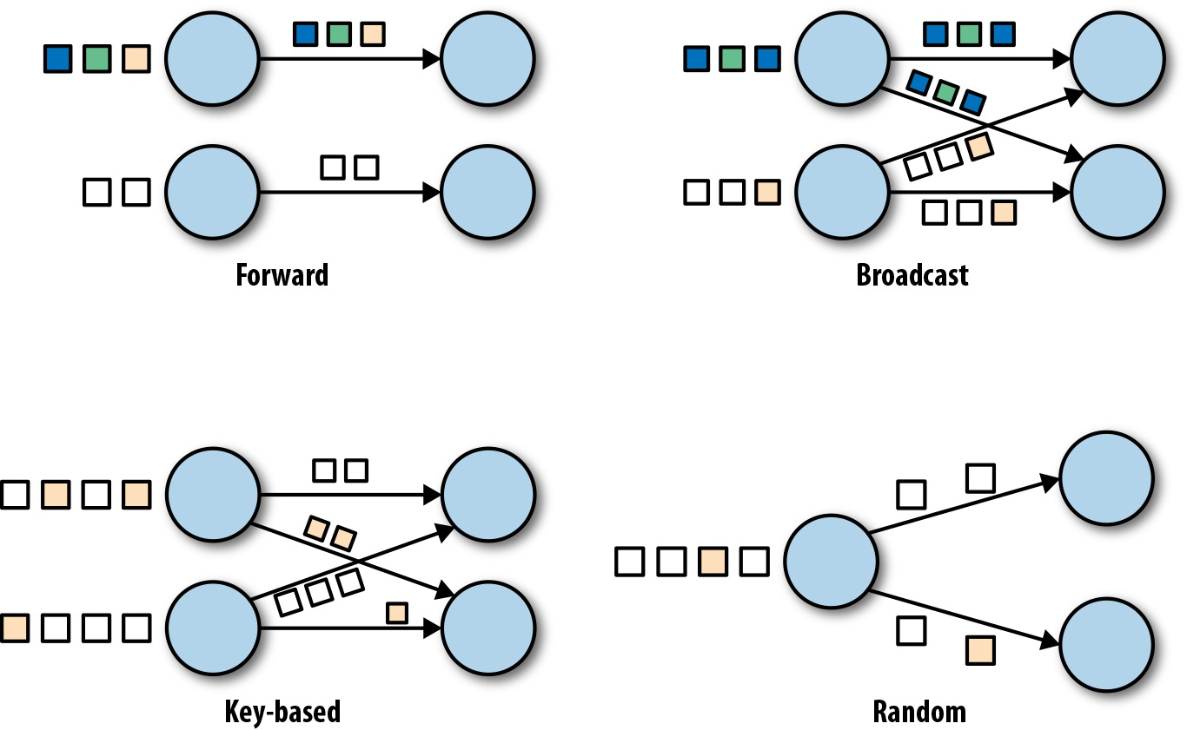
Data Exchange Strategies
Data exchange strategies define how data items are assigned to tasks in a physical dataflow graph. Data exchange strategies can be automatically chosen by the execution engine depending on the semantics of the operators or explicitly imposed by the dataflow programmer.
The *forward* strategy sends data from a task to a receiving task. If both tasks are located on the same physical machine (which is often ensured by task schedulers), this exchange strategy avoids network communication.
The *broadcast* strategy sends every data item to all parallel tasks of an operator. Because this strategy replicates data and involves network communication, it is fairly expensive.
The *key-based* strategy partitions data by a key attribute and guarantees that data items having the same key will be processed by the same task.
The *random* strategy uniformly distributes data items to operator tasks in order to evenly distribute the load across computing tasks.

Slide 73
Partitioner Algorithm-I
Partitioning transformations correspond to the data exchange strategies we just introduced in “Data Exchange Strategies”. These operations define how events are assigned to tasks. When building applications with the DataStream API the system automatically chooses data partitioning strategies and routes data to the correct destination depending on the operation semantics and the configured parallelism.
Sometimes it is necessary or desirable to control the partitioning strategies at the application level or define custom partitioners. For instance, if we know that the load of the parallel partitions of a DataStream is skewed, we might want to rebalance the data to evenly distribute the computation load of subsequent operators. Alternatively, the application logic might require that all tasks of an operation receive the same data or that events be distributed following a custom strategy.
There are 8 types of Partitioner Algorithm provided by Flink API
ForwardPartitioner
ShufflePartitioner
RebalancePartitioner
BroadcastPartitioner
KeyGroupStreamPartitioner
GlobalPartitioner
RescalePartitioner
CustomPartitioner

Slide 74
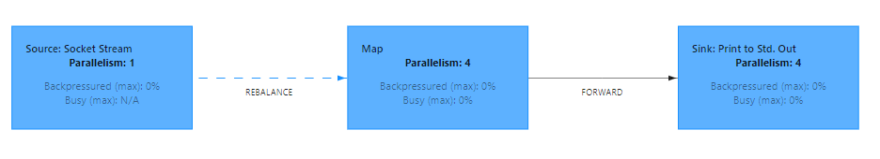
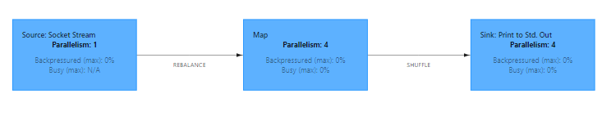
Partitioner Algorithm-II
Forward Partitioner that forwards elements only to the locally running downstream operation.
Shuffle Partitioner that distributes the data equally by selecting one output channel randomly.

Slide 75
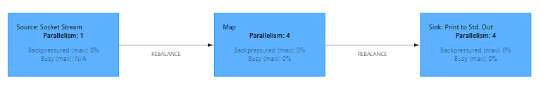
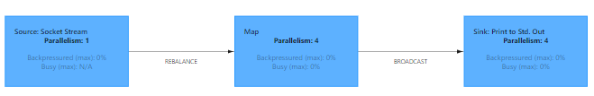
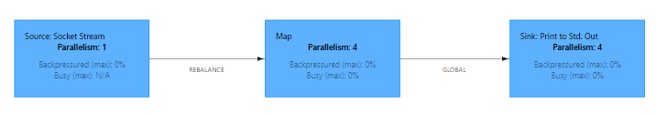
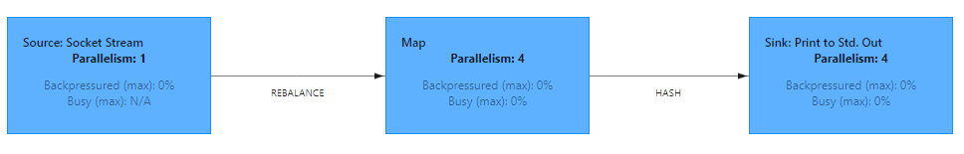
Partitioner Algorithm-III
Rebalance Partitioner that distributes the data equally by cycling through the output channels.
Broadcast Partitioner that selects all the output channels.
Global Partitioner that sends all elements to the downstream operator with subtask ID=0.
KeyStreamPartitioner selects the target channel based on the key group index.

Slide 76
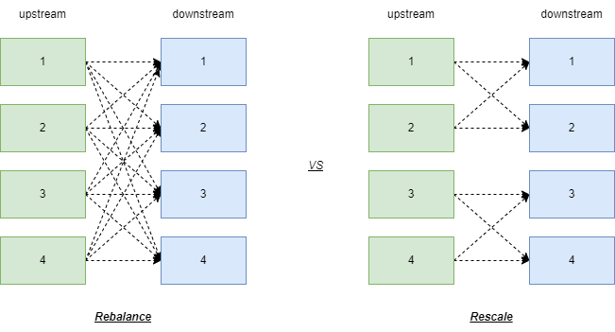
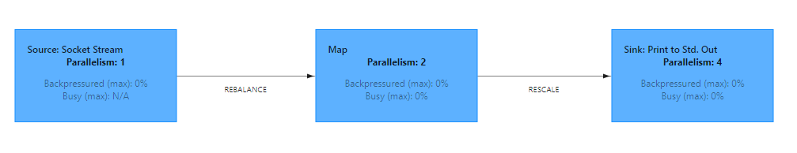
Partitioner Algorithm-IV
The rescale also distributes events in a round-robin fashion, but only to a subset of successor tasks. In essence, the rescale partitioning strategy offers a way to perform a lightweight load rebalance when the number of sender and receiver tasks is not the same. The rescale transformation is more efficient if the number of receiver tasks is a multitude of the number of sender tasks

Slide 77
Accumulators & Counters
Accumulators are simple constructs with an add operation and a final accumulated result, which is available after the job ended.
The most straightforward accumulator is a counter: You can increment it using the Accumulator.add(V value) method. At the end of the job Flink will sum up (merge) all partial results and send the result to the client. Accumulators are useful during debugging or if you quickly want to find out more about your data.
Flink currently has the following built-in accumulators. Each of them implements the Accumulator interface.
IntCounter , LongCounter and DoubleCounter : See below for an example using a counter.
Histogram : A histogram implementation for a discrete number of bins. Internally it is just a map from Integer to Integer. You can use this to compute distributions of values, e.g. the distribution of words-per-line for a word count program.

Slide 78
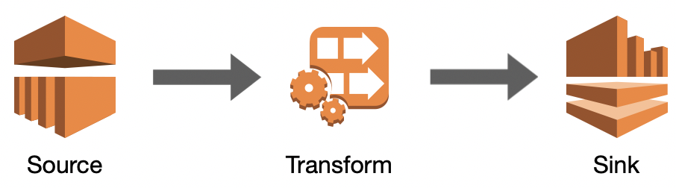
Flink Sink Connector
Data sinks consume DataStreams and forward them to files, sockets, external systems, or print them.
Socket Sink
Local File System Sink
Hdfs File System Sink
JDBC Sink
Apache Kafka Sink
Mongodb Sink
Custom Sink

Slide 79
05
Flink Window API

Slide 80
Flink Window API
Windowing
Window Assigner
Window Functions
Trigger & Evictor
What is Windowing
Keyed window vs no-keyed window
Window category
Window lifecycle
Tumbling Window
Sliding Window
Session Window
Global Window
Count Window
ReduceFunction
AggregateFunction
ProcessWindowFunction
WindowFunction
Rolling aggregations
What is Trigger
What is Evictor
How to custom Trigger
How to custom Evictor
Timer & TimerService
KeyedProcessFunction

Slide 81
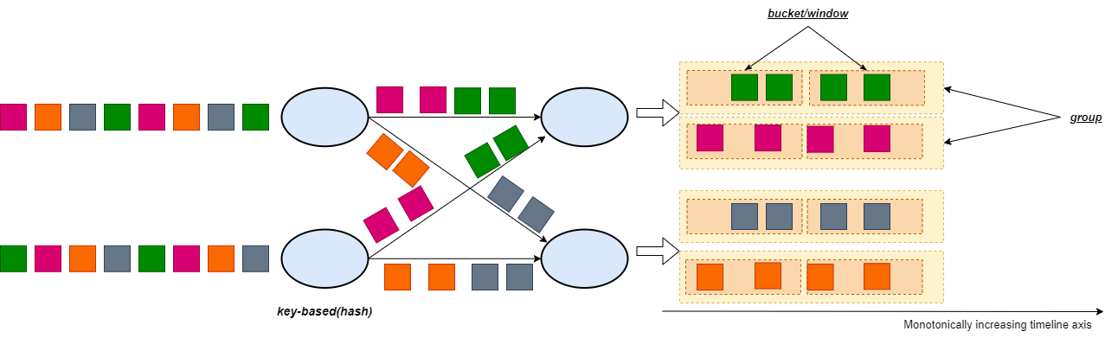
Windowing
Apache Flink is a distributed computing framework that naturally supports infinite stream data processing. In Flink, the Window operation can split infinite streams into “buckets” of finite size, over which we can apply computations.
Window operation in Flink can be either time-driven (referred to as the Time Window) or data-driven (Count Window).

Slide 82
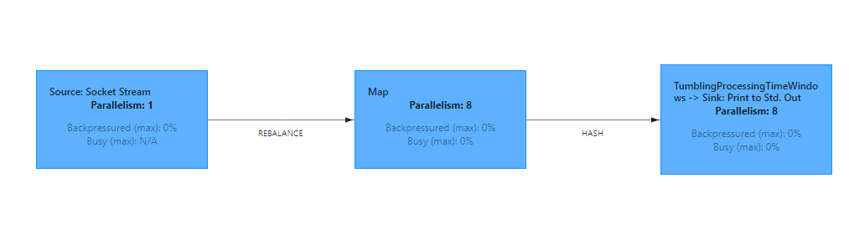
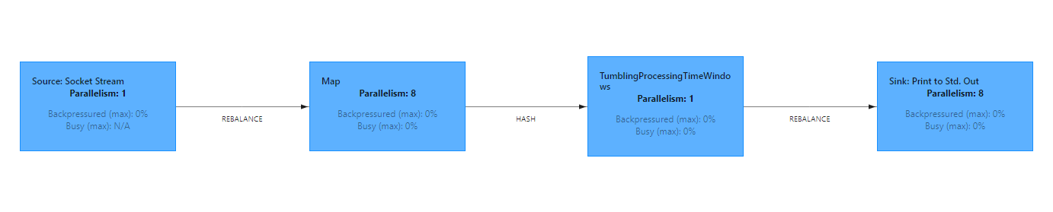
Keyed window vs no-keyed window
Before perform window operation, The first thing to specify is whether your stream should be keyed or not. This has to be done before defining the window. Using the `keyBy(...)` will split your infinite stream into logical keyed streams. If `keyBy(...)` is not called, your stream is not keyed.
In the case of keyed streams, any attribute of your incoming events can be used as a key . Having a keyed stream will allow your windowed computation to be performed in parallel by multiple tasks, as each logical keyed stream can be processed independently from the rest. All elements referring to the same key will be sent to the same parallel task.
In case of non-keyed streams, your original stream will not be split into multiple logical streams and all the windowing logic will be performed by a single task, *i.e.* with parallelism of 1.

Slide 83
no-keyed window=dummy keyed window
@PublicEvolving
public AllWindowedStream(DataStream<T> input, WindowAssigner<? super T, W> windowAssigner) {
this.input = input.keyBy(new NullByteKeySelector<T>());
this.windowAssigner = windowAssigner;
this.trigger = windowAssigner.getDefaultTrigger(input.getExecutionEnvironment());
}

Slide 84
Window Definition - I
The window assigner defines how elements are assigned to windows. This is done by specifying the WindowAssigner of your choice in the window(...) (for keyed streams) or the windowAll() (for non-keyed streams) call.
A WindowAssigner is responsible for assigning each incoming element to one or more windows. Flink comes with pre-defined window assigners for the most common use cases, namely tumbling windows, sliding windows, session windows and global windows.
Time-based windows have a start timestamp (inclusive) and an end timestamp (exclusive) that together describe the size of the window. In code, Flink uses TimeWindow when working with time-based windows which has methods for querying the start- and end-timestamp and also an additional method maxTimestamp() that returns the largest allowed timestamp for a given windows.

Slide 85
Window Definition - II
Driven | Tumbling Window | Sliding Window | Session Window | Global Window
Time-Based | √ | √ | √ | √
Count-Based | √ | √ | × | ×
√: Support
×: Not Support

Slide 86
Window lifecycle
A window is created as soon as the first element that should belong to this window arrives, and the window is completely removed when the time (event or processing time) passes its end timestamp plus the user-specified allowed lateness.
Each window will have a Trigger and a function attached to it. The function will contain the computation to be applied to the contents of the window, while the Trigger specifies the conditions under which the window is considered ready for the function to be applied.
A trigger can also decide to purge a window’s contents any time between its creation and removal. Purging in this case only refers to the elements in the window, and not the window metadata. This means that new data can still be added to that window.
You also can specify an Evictor which will be able to remove elements from the window after the trigger fires and before and/or after the function is applied.
12:03
12:04
12:06
12:01
(12:10
12:05]
(12:05
12:00]

Slide 87
Window Assigner
Flink provides built-in window assigners for the most common windowing use cases. All assigners we discuss here are time-based, Time-based window assigners assign an element based on its event-time timestamp or the current processing time to windows. the time-based we discussed are processing time in this section.
The window assigner defines how elements are assigned to windows. This is done by specifying the WindowAssigner of your choice in the window(...) (for keyed streams) or the windowAll() (for non-keyed streams) call.
A WindowAssigner is responsible for assigning each incoming element to one or more windows.
Flink comes with pre-defined window assigners for the most common use cases, namely tumbling windows, sliding windows, session windows and global windows
Time-based windows have a start timestamp (inclusive) and an end timestamp (exclusive) that together describe the size of the window. In code, Flink uses TimeWindow when working with time-based windows which has methods for querying the start- and end-timestamp and also an additional method maxTimestamp() that returns the largest allowed timestamp for a given windows.
size
end timestamp(exclusive)
start timestamp(inclusive)

Slide 88
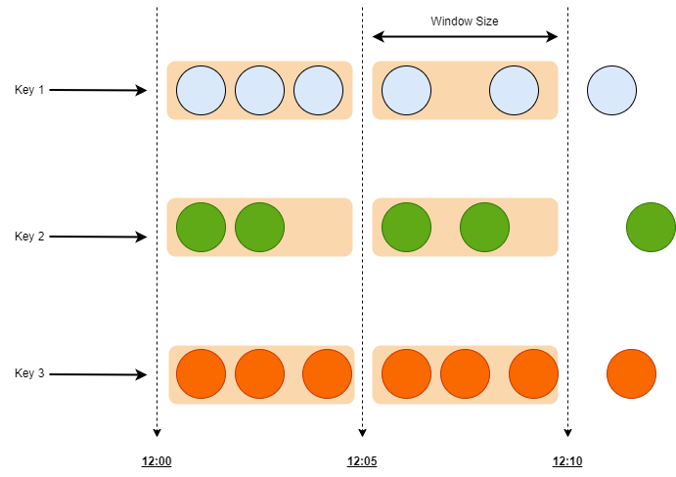
Tumbling Windows
A tumbling windows assigner assigns each element to a window of a specified window size. Tumbling windows have a fixed size and do not overlap. For example, if you specify a tumbling window with a size of 5 minutes, the current window will be evaluated and a new window will be started every five minutes as illustrated by the following figure.
The features of Tumbling Windows:
Fixed size
no overlap
have start and end timestamp(Epoch Time)

Slide 89


Inside TimeWindows(Tumbling Window)
When emit the window computation result to downstream?
How to implement the end timestamp exclusive in Flink Framework(suppose a window range [1:00-1:05), so an element timestamp is 1:05 belong current window or next)?
TimerService
register timer
register timer
register timer

Slide 90
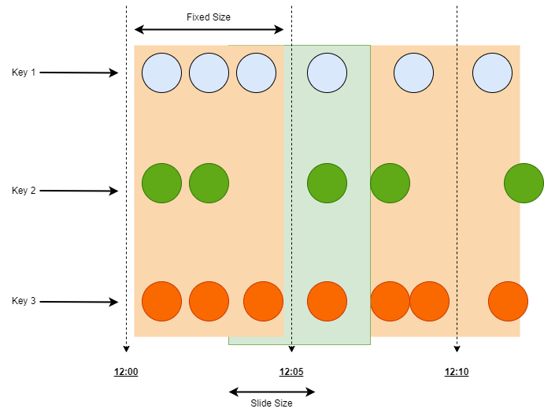
Sliding Windows
The sliding windows assigner assigns elements to windows of fixed length. Similar to a tumbling windows assigner, the size of the windows is configured by the window size parameter. An additional window slide parameter controls how frequently a sliding window is started. Hence, sliding windows can be overlapping if the slide is smaller than the window size. In this case elements are assigned to multiple windows.
The features of Sliding Windows:
Fixed size
overlapping
one element will be assigned into multiple window
have start and end timestamp(epoch time)

Slide 91
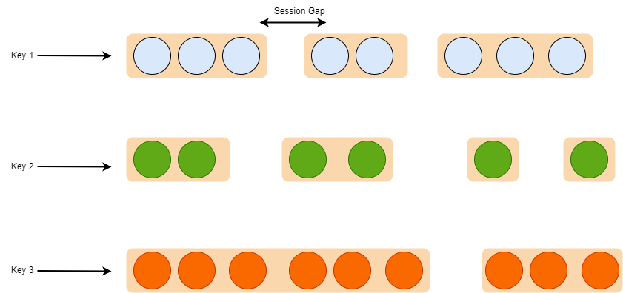
Session Windows
The session windows assigner groups elements by sessions of activity. Session windows do not overlap and do not have a fixed start and end time, in contrast to tumbling windows and sliding windows. Instead a session window closes when it does not receive elements for a certain period of time, i.e., when a gap of inactivity occurred. A session window assigner can be configured with either a static session gap or with a session gap extractor function which defines how long the period of inactivity is. When this period expires, the current session closes and subsequent elements are assigned to a new session window.
The features of Session Windows:
Dynamic window size
non-overlapping
have start and end timestamp but dynamic

Slide 92

Global Windows
A global windows assigner assigns all elements with the same key to the same single global window. This windowing scheme is only useful if you also specify a custom trigger. Otherwise, no computation will be performed, as the global window does not have a natural end at which we could process the aggregated elements.
The features of Global Windows:
no window size
non-overlapping
no start and end timestamp
no computation result otherwise attached trigger at code

Slide 93

Count Windows
Count window set the window size based on how many elements exist within that window. A window is fired when it has more than a certain number of elements . Window size will be different but the number of elements in that window will always be the same. Count windows can have overlapping windows or non-overlapping, both are possible. The count window in Flink is applied to keyed streams.

Slide 94

Window Function
After defining the window assigner, we need to specify the computation that we want to perform on each of these windows. This is the responsibility of the window function, which is used to process the elements of each (possibly keyed) window once the system determines that a window is ready for processing.
Rolling aggregation Functions
sum
min
max
minBy
maxBy
reduce-> ReduceFunction
aggregate-> AggregateFunction
process->ProcessWindowFunction
ProcessWindowFunction with Incremental Aggregation
apply-> WindowFunction(Legacy)
Side Output

Slide 95

Window Trigger
Each window will have a Trigger attached to it, the Trigger specifies the conditions under which the window is considered ready for the function to be applied. A triggering policy might be something like “when the number of elements in the window is more than 4”, or “when the watermark passes the end of the window”. A trigger can also decide to purge a window’s contents any time between its creation and removal.
For example, the default triggers of the previously discussed time windows fire when the processing time or the watermark exceed the timestamp of the window’s end boundary.
Triggers have access to time properties and timers, and can work with state. Hence, they are as powerful as process functions. For example, you can implement triggering logic to fire when the window receives a certain number of elements, when an element with a specific value is added to the window.
In short the Triggers define when a window is evaluated and its results are emitted

Slide 96
Trigger and TriggerResult
Trigger API
TriggerResult
TriggerResult onElement(T element, long timestamp, W window, TriggerContext ctx): Called for every element that gets added to a window
TriggerResult onProcessingTime( long timestamp, W window, TriggerContext ctx): Called when a processing-time timer fires
TriggerResult onEventTime(long timestamp, W window, TriggerContext ctx):Called when an event-time timer fires
boolean canMerge():Returns true if this trigger supports merging of trigger state
void onMerge(W window, OnMergeContext ctx): Called when several windows have been merged into one window and the state of the triggers needs to be merged
void clear(W window, TriggerContext ctx): Clears any state that the trigger might hold for the given window,This method is called when a window is purged
TriggerContext: A context object that is given to Trigger methods to allow them to register timer callbacks and deal with state
CONTINUE:No action is taken.
FIRE: If the window operator has a ProcessWindowFunction, the function is called and the result is emitted. If the window only has an incremetal aggregation function (ReduceFunction or AggregateFunction) the current aggregation result is emitted. The state of the window is not changed.
PURGE: The content of the window is completely discarded and the window including all metadata is removed. Also, the ProcessWindowFunction.clear() method is invoked to clean up all custom per-window state.
FIRE_AND_PURGE: Evaluates the window first (FIRE) and subsequently removes all state and metadata (PURGE).

Slide 97

Custom Trigger Applied to GlobalWindow
Implement logic to prepare the window based on 2 conditions: either it has received specified number of events or time has passed specified seconds.

Slide 98

Evictor
The Evictor is an optional component in Flink’s windowing mechanism. It can remove elements from a window before or after the window function is evaluated.
The Flink provided 3 built-in Evictors
TimeEvictor: keeps elements for a certain amount of time. Elements older than current_time - keep_time are evicted
CountEvictor: An Evictor that keeps up to a certain amount of elements.
DeltaEvictor: An Evictor that keeps elements based on a DeltaFunction and a threshold. Eviction starts from the first element of the buffer and removes all elements from the buffer which have a higher delta then the threshold.
Note: When using an evictor window performance will degrade significantly, since incremental aggregation of window results better no use.

Slide 99

TimerService & Timer
Timers are what make Flink streaming applications reactive and adaptable to processing and event time changes.
4 characteristics of Timers in Apache Flink
Timers are registered on a KeyedStream: Since timers are registered and fired per key, a KeyedStream is a prerequisite for any kind of operation and function using Timers in Apache Flink.
Timers are automatically deduplicated: The TimerService automatically deduplicates Timers, always resulting in at most one timer per key and timestamp. This means that when multiple Timers are registered for the same key or timestamp, the onTimer() method will be called just once.
Timers are checkpointed: Timers are checkpointed by Flink, just like any other managed state.
Timers can be deleted

Slide 100
06
WaterMark

Slide 101
WaterMark
Time Semantics
Watermark introduce
Watermark API
DataStream Join
Processing Time
Event Time
Processing Time vs Event Time
What is Watermark
out-of-orderness elements
late data
Watermark Strategy
Watermark Propagation
Idle Sources
Allowed Lateness
Late data side output
Window Join
Interval Join

Slide 102


Time Semantics
When dealing with a potentially unbounded stream of continuously arriving events, time becomes a central aspect of applications. Let’s assume you want to compute results continuously, maybe every hour. What would one hour really mean in the context of our streaming application?
01:58
01:55
01:32
01:02
02:41
02:33
01:59
02:01
01:58
01:55
01:32
01:02
01:59
02:41
02:58
03:56
03:45
03:02
02:58
02:33
02:01
01:59
03:56
03:45
03:02
02:58

Slide 103
EventTime and ProcessTime
Processing Time
Event Time
Processing time is the time of the local clock on the machine where the operator processing the stream is being executed. A processing-time window includes all events that happen to have arrived at the window operator within a time period, as measured by the system clock of its machine.
When a streaming program runs on processing time, all time-based operations (like time windows) will use the system clock of the machines that run the respective operator. An hourly processing time window will include all records that arrived at a specific operator between the times when the system clock indicated the full hour. For example, if an application begins running at 9:15am, the first hourly processing time window will include events processed between 9:00am and 10:00am (epoch time), the next window will include events processed between 10:00am and 11:00am, and so on.
Processing time is the simplest notion of time and requires no coordination between streams and machines. It provides the best performance and the lowest latency.
Event time is the time when an event in the stream actually happened. Event time is based on a timestamp that is attached to the events of the stream. Timestamps usually exist inside the event data before they enter the processing pipeline.
Event time completely decouples the processing speed from the results. Operations based on event time are predictable and their results are deterministic.
The event time is typically embedded within the records before they enter Flink, and that event timestamp can be extracted from each record. In event time, the progress of time depends on the data, not on any system clocks. Event time programs must specify how to generate Event Time Watermarks, which is the mechanism that signals progress in event time.
By relying on event time, we can guarantee result correctness.
Event timing introduce two problems: time out of order and late data.

Slide 104

Event Time vs Processing Time
Processing-time windows introduce the lowest latency possible. Since you do not take into consideration late events and out-of-order events, a window simply needs to buffer up events and immediately trigger computation once the specified time length is reached.
Event time guarantees deterministic results and allows you to deal with events that are late or even out of order

Slide 105
What is Watermark
A watermark is a global progress metric that indicates the point in time when we are confident that no more delayed events will arrive. In essence, watermarks provide a logical clock that informs the system about the current event time. When an operator receives a watermark with time T, it can assume that no further events with timestamp less than T will be received. Watermarks are essential for both event-time windows and operators handling out-of-order events. Once a watermark has been received, operators are signaled that all timestamps for a certain time interval have been observed and either trigger computation or order received events.
Watermarks provide a configurable tradeoff between results confidence and latency. Eager watermarks ensure low latency but provide lower confidence. In this case, late events might arrive after the watermark, and we should provide some code to handle them. On the other hand, if watermarks are too relaxed, you have high confidence but you might unnecessarily increase processing latency.
Flink event-time application must provide watermarks. Watermarks are used to derive the current event time at each task in an event-time application. Time-based operators use this time to trigger computations and make progress. For example, a time-window task finalizes a window computation and emits the result when the task event-time passes the window’s end boundary.
Watermarks have two basic properties:
monotonically increasing
They are related to record timestamps.

Slide 106
How to generate the Watermark
1
Event time is always monotonically increasing
The watermark generated for each individual element
The data volume of watermark too huge
DataStream
/
Elements
10
9
8
7
6
5
4
3
2
1
Logic Clock
/
Watermark
10
9
8
7
6
5
4
3
2
1
emit
emit

Slide 107
How to generate the Watermark
2
Event time is always monotonically increasing
The watermark generated by periodically
The event timestamp out-of-orderness is norm
DataStream
/
Elements
10
9
8
7
6
5
4
3
2
1
Logic Clock
/
Watermark
10
7
5
3
emit
emit

Slide 108
Out-of-orderness elements and late data
DataStream
/
Elements
8
10
7
9
5
4
6
2
3
1
Logic Clock
/
Watermark
10
9
6
3
9
6
3
7
9
5
6
2
3
1
(10 5]
(5 0]

Slide 109
Handle the out-of-orderness and late data
DataStream
/
Elements
8
10
7
9
5
4
6
2
3
1
Logic Clock
/
Watermark
8
7
4
1
maximum out-of-orderness: 2 m
10-2
9-2
6-2
3-2
8
7
4
1
8
7
9
5
6
4
2
3
1
(10 5]
(5 0]

Slide 110
Watermark Strategy
In order to work with event time, Flink needs to know the events timestamps, meaning each element in the stream needs to have its event timestamp assigned. This is usually done by extracting the timestamp from some field in the element by using a TimestampAssigner.
Timestamp assignment goes hand-in-hand with generating watermarks, which tell the system about progress in event time. You can configure this by specifying a WatermarkGenerator.
The Flink API expects a WatermarkStrategy that contains both a TimestampAssigner and WatermarkGenerator. A number of common strategies are available out of the box as static methods on WatermarkStrategy, but users can also build their own strategies when required.
assignTimestampsAndWatermarks():
WatermarkStrategy.forMonotonousTimestamps: Creates a watermark strategy for situations with monotonously ascending timestamps.
WatermarkStrategy.forBoundedOutOfOrderness: Creates a watermark strategy for situations where records are out of order, but you can place an upper bound on how far the events are out of order. An out-of-order bound B means that once the an event with timestamp T was encountered, no events older than T - B will follow any more.
WatermarkStrategy.forGenerator(): Creates a watermark strategy based on an existing WatermarkGeneratorSupplier.
There are two places in Flink applications where a WatermarkStrategy can be used
Directly on source operator
on transformation operator

Slide 111

WatermarkGenerator & TimestampAssigner
The WatermarkGenerator generates watermarks either based on events or periodically (in a fixed interval).
onEvent: called for every event, allows the watermark generator to examine and remember the event timestamps, or to emit a watermark based on the event itself.
onPeriodicEmit: Called periodically, and might emit a new watermark.
TimestampAssigner assigns event time timestamps to elements. These timestamps are used by all functions that operate on event time.

Slide 112
Watermark Propagation-I
1
4
1
4
Source
watermark strategy
window process
sink
1
1
Source 1
watermark strategy 1
1
sink 1
5
5
Source 2
watermark strategy 2
window process
sink 2

Slide 113

Watermark Propagation-II
The task updates its internal event-time clock based on the watermark’s timestamp.
The task’s time service identifies all timers with a time smaller than the updated event time.
The task emits a watermark with the updated event time.

Slide 114

Process Idle Sources
Up to this point, we know that Watermarks help make progress and update the event-time clock. But what happens when a source becomes idle, i.e produces no data?
With no events arriving, an idle source can cause the entire pipeline to stall, as it has no basis for advancing the current watermark. This can frequently be the root cause for cases when while we perform a window or join operation, we observe that no results are being emitted downstream.
Add an idle timeout to the watermark strategy. If no records flow in a partition of a stream for that amount of time, then that partition is considered "idle" and will not hold back the progress of watermarks in downstream operators.

Slide 115
Allowed Lateness
When working with event-time windowing, it can happen that elements arrive late, By default, late elements are dropped when the watermark is past the end of the window.
However, Flink allows to specify a maximum allowed lateness for window operators. Allowed lateness specifies by how much time elements can be late before they are dropped, and its default value is 0.
Elements that arrive after the watermark has passed the end of the window but before it passes the end of the window plus the allowed lateness, are still added to the window.
Depending on the trigger used, a late but not dropped element may cause the window to fire again. This is the case for the EventTimeTrigger.

Slide 116
Getting late data as a side output
Whether it's setting too relaxed watermark or specify the allowedLateness time. we can not 100% avoid the occurrence of data late.
When specifying an allowed lateness greater than 0, the window along with its content is kept after the watermark passes the end of the window. In these cases, when a late but not dropped element arrives, it could trigger another firing for the window. These firings are called `late firings`, as they are triggered by late events and in contrast to the `main firing` which is the first firing of the window.
The Flink API provide a feature that you can get a stream of the data that was discarded as late.

Slide 117
Joins
A common requirement when working with streams is to connect or join the events of two streams. Flink’s DataStream API features two built-in operators to join streams with a temporal condition: the interval join and the window join.
Window Join: A window join joins the elements of two streams that share a common key and lie in the same window. These windows can be defined by using a window assigner and are evaluated on elements from both of the streams.
Interval join:The interval join joins elements of two streams (we’ll call them A & B for now) with a common key and where elements of stream B have timestamps that lie in a relative time interval to timestamps of elements in stream A.

Slide 118

Window Join
As the name suggests, the window join is based on Flink’s windowing mechanism. Elements of both input streams are assigned to common windows and joined (or cogrouped) when a window is complete.
thisStream.join(otherStream)
.where(<KeySelector>)
.equalTo(<KeySelector>)
.window(<WindowAssigner>)
.apply(<JoinFunction>);

Slide 119

Interval Join
The interval join joins elements of two streams (we’ll call them A & B for now) with a common key and where elements of stream B have timestamps that lie in a relative time interval to timestamps of elements in stream A.
This can also be expressed more formally as `b.timestamp ∈ [a.timestamp + lowerBound; a.timestamp + upperBound]` or `a.timestamp + lowerBound <= b.timestamp <= a.timestamp + upperBound`
where a and b are elements of A and B that share a common key. Both the lower and upper bound can be either negative or positive as long as the lower bound is always smaller or equal to the upper bound. The interval join currently only performs inner joins.

Slide 120
07
Stateful Operators

Slide 121
Stateful Operators
Stateful & State
Keyed State
Operator & Broadcast State
State Backend
What is stateful application
State in Apache Flink
ValueState
ListState
MapState
ReducingState
AggregatingState
State Time to Alive(TTL)
Operator State
Broadcast State
Stateful Source Function
HashMapStateBackend
EmbeddedRocksDBStateBackend

Slide 122
Stateful Application
Stateful operators and user functions are common building blocks of stream processing applications. In fact, most nontrivial operations need to memorize records or partial results because data is streamed and arrives over time. Many of Flink’s built-in DataStream operators, sources, and sinks are stateful and buffer records or maintain partial results or metadata. For instance, a window operator collects input records for a ProcessWindowFunction or the result of applying a ReduceFunction, a ProcessFunction memorizes scheduled timers, and some sink functions maintain state about transactions to provide exactly-once functionality. In addition to built-in operators and provided sources and sinks, Flink’s DataStream API exposes interfaces to register, maintain, and access state in user-defined functions.
<Apache,1>
<Apache,2>
Sum
Print
<Apache,1>
<Apache,2>
Flink
Apache
Flink
Apache
Sum
Print
<Flink,1>
<Flink,2>
<Flink,1>
<Flink,2>

Slide 123
Stateful Application
Where is the state data stored?
How to define and access the state in Flink Application?
How do I restore state after the Flink application restarts or flink application crashed?
How to ensure data fault tolerance in state?

Slide 124
State API in Flink
Keyed State: If you want to use keyed state, you first need to specify a key on a `DataStream` that should be used to partition the state, and then applied the state at keyedstream operators.
ValueState<T>: This keeps a value that can be updated and retrieved
ListState<T>: This keeps a list of elements. You can append elements and retrieve an `Iterable` over all currently stored elements.
ReducingState<T>: This keeps a single value that represents the aggregation of all values added to the state.
AggregatingState<IN, OUT>: This keeps a single value that represents the aggregation of all values added to the state.
MapState<UK, UV>: This keeps a list of mappings. You can put key-value pairs into the state and retrieve an `Iterable` over all currently stored mappings
Operator State: Operator State (or non-keyed state) is state that is bound to one parallel operator instance. each parallel instance of operator have it own state.
Broadcast State: Broadcast State is a special type of Operator State. It was introduced to support use cases where records of one stream need to be broadcasted to all downstream tasks, where they are used to maintain the same state among all subtasks. This state can then be accessed while processing records of a second stream.

Slide 125


operator state vs keyed state

Slide 126

Keyed State
Keyed state is maintained in what can be thought of as an embedded key/value store. The state is partitioned and distributed strictly together with the streams that are read by the stateful operators. Hence, access to the key/value state is only possible on keyed streams, i.e. after a keyed/partitioned data exchange, and is restricted to the values associated with the current event’s key. Aligning the keys of streams and state makes sure that all state updates are local operations, guaranteeing consistency without transaction overhead. This alignment also allows Flink to redistribute the state and adjust the stream partitioning transparently.
ValueState<T>: This keeps a value that can be updated and retrieved . The value can be set using update(T) and retrieved using T value().
ReducingState<T>: This keeps a single value that represents the aggregation of all values added to the state.
AggregatingState<IN, OUT>: This keeps a single value that represents the aggregation of all values added to the state. Contrary to ReducingState, the aggregate type may be different from the type of elements that are added to the state.
ListState<T>: This keeps a list of elements. You can append elements and retrieve an Iterable over all currently stored elements. Elements are added using add(T) or addAll(List<T>), the Iterable can be retrieved using Iterable<T> get(). You can also override the existing list with update(List<T>)
MapState<UK, UV>: This keeps a list of mappings. You can put key-value pairs into the state and retrieve an Iterable over all currently stored mappings. Mappings are added using put(UK, UV) or putAll(Map<UK, UV>). The value associated with a user key can be retrieved using get(UK). The iterable views for mappings, keys and values can be retrieved using entries(), keys() and values() respectively. You can also use isEmpty() to check whether this map contains any key-value mappings.

Slide 127

State Time-To-Live(TTL)
A time-to-live (TTL) can be assigned to the keyed state of any type. If a TTL is configured and a state value has expired, the stored value will be cleaned up.
All state collection types support per-entry TTLs. This means that list elements and map entries expire independently.
In order to use state TTL one must first build a StateTtlConfig configuration object. The TTL functionality can then be enabled in any state descriptor by passing the configuration.

Slide 128
Operator State
Operator State (or non-keyed state) is state that is bound to one parallel operator instance. The Kafka Connector is a good motivating example for the use of Operator State in Flink. Each parallel instance of the Kafka consumer maintains a map of topic partitions and offsets as its Operator State.
The Operator State interfaces support redistributing state among parallel operator instances when the parallelism is changed. There are different schemes for doing this redistribution.
In a typical stateful Flink Application you don’t need operators state. It is mostly a special type of state that is used in source/sink implementations and scenarios where you don’t have a key by which state can be partitioned.
To use operator state, a stateful function can implement the CheckpointedFunction interface. The CheckpointedFunction interface provides access to non-keyed state with different redistribution schemes. It requires the implementation of two methods:
void snapshotState(FunctionSnapshotContext context) throws Exception;
void initializeState(FunctionInitializationContext context) throws Exception;

Slide 129
State redistribution in Operator
Currently in operator state only support list-style state, The state is expected to be a List of serializable objects, independent from each other, thus eligible for redistribution upon rescaling.
Even-split redistribution: Each operator returns a List of state elements. The whole state is logically a concatenation of all lists. On restore/redistribution, the list is evenly divided into as many sublists as there are parallel operators. Each operator gets a sublist, which can be empty, or contain one or more elements.
Union redistribution: Each operator returns a List of state elements. The whole state is logically a concatenation of all lists. On restore/redistribution, each operator gets the complete list of state elements. Do not use this feature if your list may have high cardinality.
subtask-1
subtask-1
subtask-1
subtask-1
state
state
state
state
subtask-2
element1
element2
element1
element2
element3
element4
subtask-2
element1
element3
subtask-2
element1
element2
element1
element2
element3
element4
subtask-2
element1
element2
element3
element4
state
state
state
state
element3
element4
element2
element4
element3
element4
element1
element2
element3
element4

Slide 130
Broadcast State
Broadcast State is a special type of Operator State. It was introduced to support use cases where records of one stream need to be broadcasted to all downstream tasks, where they are used to maintain the same state among all subtasks. This state can then be accessed while processing records of a second stream.
A common usage pattern for broadcast state is: broadcast the rules to process operator rather than hardcode.
BroadcastStream
BroadcastConnectedStream
conf
operator
operator
broadcast
process
broadcast
broadcast
datastream
operator
1/2
operator
1/2
connect
element
process
event
operator
2/2
operator
2/2
element
process

Slide 131

State Backend
Where is the state stored?
A State Backend defines how the state of a streaming application is stored locally within the cluster. Different State Backends store their state in different fashions, and use different data structures to hold the state of a running application.
A state backend is responsible for two things: local state management and checkpointing state to a remote location
Out of the box, Flink bundles 3 state backends:
HashMapStateBackend
FsStateBackend(Deprecated)
EmbeddedRocksDBStateBackend

Slide 132
HashMapStateBackend
This state backend holds the working state in the memory (JVM heap) of the TaskManagers, the Key/value state and window operators hold hash tables that store the values, triggers, etc.
If nothing else is configured, the system will use the HashMapStateBackend.
This backend can either be configured within the application (by creating the backend with the respective constructor parameters and setting it on the execution environment) or by specifying it in the Flink configuration.
StreamExecutionEnvironment env = StreamExecutionEnvironment....
env.setStateBackend(new HashMapStateBackend());
state.backend.type: hashmap
# state.checkpoints.dir: hdfs://namenode-host:port/flink-checkpoints
# Default target directory for savepoints, optional.
# state.savepoints.dir: hdfs://namenode-host:port/flink-savepoints
# state.backend.incremental: false

Slide 133
EmbeddedRocksDBStateBackend
This backend uses RocksDB by Facebook to store the data. If you are not aware of RocksDB, it’s an embeddable key-value store which offers ACID guarantees. It is based on LevelDB by Google but offers much better write performance.
Flink chose to use RocksDB instead of some of the most popular embeddable storage such as SQLlite because of its high write performance which comes from the LSM architecture based design.
Since RocksDB also maintains an in-memory table (also known as mem-table) along with bloom filters, reading recent data also is extremely fast.
Each task manager maintains its own Rocks DB file and the backup of this state is checkpointed to a durable store such as HDFS.
StreamExecutionEnvironment env = StreamExecutionEnvironment....
env.setStateBackend(new EmbeddedRocksDBStateBackend());
state.backend.type: rocksdb
# state.checkpoints.dir: hdfs://namenode-host:port/flink-checkpoints
# Default target directory for savepoints, optional.
# state.savepoints.dir: hdfs://namenode-host:port/flink-savepoints
# state.backend.incremental: false

Slide 134
EmbeddedRocksDBStateBackend
When deciding between HashMapStateBackend and RocksDB, it is a choice between performance and scalability. HashMapStateBackend is very fast as each state access and update operates on objects on the Java heap; however, state size is limited by available memory within the cluster. On the other hand, RocksDB can scale based on available disk space and is the only state backend to support incremental snapshots.
The RocksDBStateBackend always performs asynchronous snapshots.
Unlike the other state backends, the amount of state that you can keep is only limited by the amount of disk space available. This allows you to keep a very large state. Hence, RocksDBStateBackend can be used for jobs with very large state, long windows, large key/value states. All the state objects stored in RocksDB are serialized which makes the state read/write operation expensive compared to a read/write from the heap. This will also reduce throughput.

Slide 135
Stateful Application(Answer)
Where is the state data stored?
The state stored locally within the flink application cluster, this is called state backend: and flink provide 2 bundles state backends: HashMapStateBackend and EmbeddedRocksDBStateBackend
How to define and access the state in Flink Application?
Totally speak, flink provides keyed state, operator state and broadcast state. the keyed state applied at keyedstream and have five types state we can use: ValueState,ListState,ReducingState,AggregatingState,MapState.
How do I restore state after the Flink application restarts or flink application crashed?
Store the state on a reliable storage system and specify savepoint when the system restarts.
How to ensure data fault tolerance in state?
We have to enable the checkedpoint function either in flink-conf.yaml or application level, the state in Backend will periodic persistence in reliable storage systems, such as hdfs, AWS S3.

Slide 136
08
Checkpoints & SavePoints & EOS

Slide 137
Checkpoints & SavePoints & EOS
Flink Checkpoints
Checkpoint configuration
SavePoints
End to End Exactly Once
What is Checkpoints
Consistent Checkpoints
Checkpoint algorithm
Checkpoint coordinator
Checkpoint basis configuration
At Least Once
Exactly Once
Align Checkpoints
Unalign Checkpoints
What is savepoints
Restoring an application from a savepoint
Specifying Unique Operator Identifiers
Checkpoints vs Savepoints
Source Connector
Process Operator
Sink Connector
Idempotent Writes
Two-phase commit
Write-Ahead-Log(WAL)
New Source Collector API

Slide 138

Consistent Checkpoints
Checkpoints make state in Flink fault tolerant by allowing state and the corresponding stream positions to be recovered, thereby giving the application the same semantics as a failure-free execution.
Flink’s recovery mechanism is based on consistent checkpoints of application state. A consistent checkpoint of a stateful streaming application is a copy of the state of each of its tasks at a point when all tasks have processed exactly the same input.
When checkpointing is enabled, managed state is persisted to ensure consistent recovery in case of failures. Where the state is persisted to reliabled storage system such as hdfs, AWS S3 during checkpointing.
When dose checkpoint trigger?
How does checkpointing work?
How to set checkpoint in the flink application?

Slide 139
Checkpoint Algorithm Evolution -I
Dataflow
3
2
Source
accumulate 1
accumulate 2
Sink
1
offset: 1
locally state
offset: 0
result 1: 1
result 2: 1
offset: 1
HDFS
offset: 0
result 1: 1
result 2: 1

Slide 140
Checkpoint Algorithm Evolution -I
Dataflow
Problems:
Performance: Every local state change needs to be backed up to remote storage, which can have a significant impact on event process performance.
State inconsistency: When the state is restored, the algorithm cannot guarantee the consistency of the state: the restored state is not affected by the same element.
3
2
Source
accumulate 1
accumulate 2
Sink
1
offset: 1
result 1: 1
result 2: 1
locally state
offset: 1
HDFS
result 1: 1
result 2: 1

Slide 141
Checkpoint Algorithm Evolution -II
5
coordinator
Dataflow
4
3
3
2
1
Source
accumulate 1
accumulate 2
Sink
2
1
offset: 1
result 1: 1
locally state
result 1: 3
result 2: 4
offset: 1
HDFS
result 1: 3
result 2: 4

Slide 142

Chandy–Lamport algorithm
Flink implements checkpointing based on the Chandy–Lamport algorithm for distributed snapshots.
Flink’s checkpointing algorithm uses a special type of record called a checkpoint barrier. Similar to watermarks, checkpoint barriers are injected by source operators into the regular stream of records and cannot overtake or be passed by other records. A checkpoint barrier carries a checkpoint ID to identify the checkpoint it belongs to and logically splits a stream into two parts.

Slide 143




Chandy–Lamport algorithm - I

Slide 144


Chandy–Lamport algorithm - II
After an application is restarted from a checkpoint, its internal state is exactly the same as when the checkpoint was taken. It then starts to consume and process all data that was processed between the checkpoint and the failure. Although this means Flink processes some messages twice (before and after the failure), the mechanism still achieves exactly-once state consistency because the state of all operators was reset to a point that had not seen this data yet.

Slide 145
How checkpoint coordinator work
Job Manager
checkpoint
coordinator
trigger checkpoint
ACK
ACK
callback
ACK
ACK
callback
callback
callback
Source
broadcast
Operator
Operator
broadcast
Sink
broadcast
snapshotted
snapshotted
snapshotted
snapshotted
checkpoint storage
latest success: chk-1

Slide 146
Checkpoint Configuration
checkpoint storage: You can set the location where checkpoint snapshots are made durable. By default Flink will use the JobManager’s heap. For production deployments it is recommended to instead use a durable filesystem. See checkpoint storage for more details on the available options for job-wide and cluster-wide configuration.
exactly-once vs. at-least-once: You can optionally pass a mode to the enableCheckpointing(n) method to choose between the two guarantee levels. Exactly-once is preferable for most applications. At-least-once may be relevant for certain super-low-latency (consistently few milliseconds) applications.
checkpoint timeout: The time after which a checkpoint-in-progress is aborted, if it did not complete by then.
minimum time between checkpoints: To make sure that the streaming application makes a certain amount of progress between checkpoints, one can define how much time needs to pass between checkpoints. If this value is set for example to 5000, the next checkpoint will be started no sooner than 5 seconds after the previous checkpoint completed, regardless of the checkpoint duration and the checkpoint interval. Note that this implies that the checkpoint interval will never be smaller than this parameter.
tolerable checkpoint failure number: This defines how many consecutive checkpoint failures will be tolerated, before the whole job is failed over. The default value is 0, which means no checkpoint failures will be tolerated, and the job will fail on first reported checkpoint failure.
number of concurrent checkpoints: By default, the system will not trigger another checkpoint while one is still in progress.
externalized checkpoints: You can configure periodic checkpoints to be persisted externally. Externalized checkpoints write their meta data out to persistent storage and are not automatically cleaned up when the job fails.
unaligned checkpoints: You can enable unaligned checkpoints to greatly reduce checkpointing times under backpressure. This only works for exactly-once checkpoints and with one concurrent checkpoint.
checkpoints with finished tasks: By default Flink will continue performing checkpoints even if parts of the DAG have finished processing all of their records. Please refer to important considerations for details.

Slide 147
Checkpoint barrier alignment
checkpoint barrier
The process operator have two upstreams.
The first upstream checkpoint barrier Arrived earlier than second.
When the process operator decide when to perform locally state backup to remote storage?
Flink framework provide 3 configuration for such scenarios.
Upstream-1
Operator
9
8
7
6
5
4
3
2
1
Upstream-2
f
e
d
c
b
a
state

Slide 148
Alignment: Exactly Once vs At Least Once
Upstream-1
checkpoint barrier
Begin Alignment
Upstream-1
checkpoint barrier
Begin Alignment
Operator
Operator
9
8
7
6
5
4
9
8
7
6
5
4
3
2
1
3
2
1
Upstream-2
f
e
d
c
b
a
state
Upstream-2
f
e
d
c
b
a
state
Upstream-1
checkpoint barrier
End Alignment
Upstream-1
checkpoint barrier
End Alignment
Operator
Operator
9
8
7
6
5
4
12
11
10
9
8
7
6
5
4
c
b
a
Upstream-2
i
h
g
f
e
d
state
Upstream-2
i
h
g
f
e
d
state
c
b
a
Upstream-1
checkpoint barrier
Checkpoint
Upstream-1
checkpoint barrier
Checkpoint
Operator
Operator
9
8
7
6
5
4
12
11
10
9
8
7
6
5
4
c
b
a
Upstream-2
i
h
g
f
e
d
state
Upstream-2
i
h
g
f
e
d
state
c
b
a
state backend
state backend

Slide 149
Unaligned: Exactly Once Only
Upstream-1
checkpoint barrier
On First Barrier
9
8
7
6
5
4
Operator
3
2
1
Upstream-2
f
e
d
c
b
a
state
output buffer
output buffer
input buffer
Upstream-1
checkpoint barrier
Tag buffers and forward barrier
9
8
7
6
5
4
Operator
3
2
1
Upstream-2
f
e
d
c
b
a
state
output buffer
output buffer
input buffer
Upstream-1
checkpoint barrier
checkpoint
9
8
7
6
5
4
Operator
3
2
1
Upstream-2
f
e
d
c
b
a
state
output buffer
output buffer
input buffer
state backend

Slide 150
Savepoints
Flink’s recovery algorithm is based on state checkpoints. Checkpoints are periodically taken and automatically discarded according to a configurable policy. Since the primary purpose of checkpoints is to provide a recovery mechanism in case of unexpected job failures.
One of Flink’s most valued and unique features are savepoints. In principle, savepoints are created using the same algorithm as checkpoints and hence are basically checkpoints with some additional metadata. Flink does not automatically take a savepoint, so a user (or external scheduler) has to explicitly trigger its creation. Flink also does not automatically clean up savepoints.
A Savepoint is a consistent image of the execution state of a streaming job, created via Flink’s checkpointing mechanism. You can use Savepoints to stop-and-resume, or upgrade your Flink application.
V1
trigger
savepoints
stop
Start
V2
storage

Slide 151

Restoring an application from a savepoint
An application consists of multiple operators. Each operator can define one or more keyed and operator states. Operators are executed in parallel by one or more operator tasks. Hence, a typical application consists of multiple states that are distributed across multiple operator tasks that can run on different TaskManager processes.
The state copies in the savepoint are organized by an operator identifier and a state name. The operator identifier and state name are required to be able to map the state data of a savepoint to the states of the operators of a starting application. When an application is started from a savepoint, Flink redistributes the savepoint data to the tasks of the corresponding operators.
The savepoint does not contain information about operator tasks. That is because the number of tasks might change when an application is started with different parallelism.

Slide 152
Apply savepoints
Trigger a yarn savepoints
bin/flink savepoint :jobId [:targetDirectory] -yid :yarnAppId
Stop the flink application with savepoints
bin/flink stop --type [native/canonical] --savepointPath [:targetDirectory] :jobId
Resume the flink application with savepoints
bin/flink run -s :savepointPath [:runArgs]

Slide 153

Specifying Unique Operator Identifiers
Unique identifiers should be specified for every operator of an application. The identifiers are written into a savepoint as metadata with the actual state data of an operator. When an application is started from a savepoint, the identifiers are used to map a state in the savepoint to the corresponding operator of the started application. Savepoint state can only be restored to an operator of a started application if their identifiers are identical.
If you do not explicitly set unique identifiers to the operators of your stateful application, you will face significant limitations when you have to evolve the application.
You can think of a savepoint as holding a map of Operator ID -> State for each stateful operator:
We strongly recommend assigning unique identifiers to every operator of an application. You can set the identifier with the uid() method

Slide 154
Checkpoints vs Savepoints
The primary purpose of checkpoints is to provide a recovery mechanism in case of unexpected job failures. A checkpoint’s lifecycle is managed by Flink, i.e. a checkpoint is created, owned, and released by Flink - without user interaction. Because checkpoints are being triggered often, and are relied upon for failure recovery.
the two main design goals for the checkpoint implementation are:
being as lightweight to create
being as fast to restore from as possible.
Savepoints are created internally with the same mechanisms as checkpoints, they are conceptually different and can be a bit more expensive to produce and restore from. Their design focuses more on portability and operational flexibility, especially with respect to changes to the job. The use case for savepoints is for planned, manual operations. For example, this could be an update of your Flink version, changing your job graph, and so on.
Savepoints are created, owned and deleted solely by the user. That means, Flink does not delete savepoints neither after job termination nor after restore.

Slide 155
End to End Exactly Once Semantics
In case of a failure, the state of the application is restored from the latest completed checkpoint and processing continues. However, being able to reset the state of an application to a consistent point is not sufficient to achieve satisfying processing guarantees for an application. Instead, the source and sink connectors of an application need to be integrated with Flink’s checkpointing and recovery mechanism and provide certain properties to be able to give meaningful guarantees.
In order to provide end to end exactly-once state consistency for an application, we have to ensure each stage guarantee exactly once semantics.
Source Connector
Process Operator
Sink Connector
The source connector has the ability to record offsets.
The source connector has the ability to replay data from the specified offset.
When flink's checkpoint mechanism is working, the offset of the source connector can be stated.
State & State Backend.
Checkpoints.
Savepoints.
Chandy-lamport algorithm
Barrier Alignment
Barrier Unalignment
Idempotent writes: An idempotent operation can be performed several times but will only result in a single change.
The second approach to achieve end-to-end exactly-once consistency is based on transactional writes. Flink provides two building blocks to implement transactional sink connectors—a generic write-ahead-log (WAL) sink and a two-phase commit sink

Slide 156

Idempotent writes
Idempotency essentially means that the effect of a successfully performed request on a resource is independent of the number of times it is executen result in a single change. On the other hand, an append operation is not an idempotent operation, because appending an element multiple times results in multiple appends. Idempotent write operations are interesting for streaming applications because they can be performed multiple times without changing the results. Hence, they can to some extent mitigate the effect of replayed results as caused by Flink’s checkpointing mechanism.
In case the application writes records with associated consistent unique identifiers, exactly-once can be achieved by an idempotent implementation of writing to DB. This means, instructing the DB to just ignore or override duplications so that even in case of re-processing of the same events there won’t be a real impact on the external table.
f(f(x))=f(x)

Slide 157

Write-Ahead-Log (WAL)
Generic Sink that emits its input elements into an arbitrary backend. This sink is integrated with Flink's checkpointing mechanism and can provide exactly-once guarantees; depending on the storage backend and sink/committer implementation.

Slide 158
Write-Ahead-Log (WAL)
Job Manager
checkpoint
coordinator
temp container
notification
final dist

Slide 159
Two-phase Commit
Flink provide one of transactional writes: TwoPhaseCommitSinkFunction,The new Version named: TwoPhaseCommittingSink. For achieving exactly-once in this scenario, Flink enables coordination of writing to an external system with its internal checkpoint mechanism. The external systems must provide a means to commit or roll back writes so that those events can be triggered and coordinated with Flink’s checkpoint management.
One common approach for coordinating commits and rollbacks in a distributed system is the two-phase commit protocol. The two-phased-commit sink should implement four different methods that Flink will call during the various phases of the checkpointing process.
beginTransaction: a transaction bundles all writes between two checkpoints, so writes are always within a scope of a transaction. This function is called at the beginning of a new checkpoint. So here you can open a DB transaction if your DB supports it, or create a temporary file in the file system. All subsequent event processing will use it until the next checkpoint.
preCommit: the pre-commit is called by the sink once it gets the checkpoint barrier after successfully persists its internal state. This will be called by every sink so that Flink JobManager (the coordinator) can commit the checkpoint only after all sinks perform the pre-commit successfully. Here, you can flush the file, close it and never write to it again. Or alternatively, start a new DB transaction for any subsequent writes that belong to the next checkpoint.
commit: the commit will be called by every sink only once the JobManager notifies them that the checkpoint is completed. In this phase, you can atomically move the pre-committed file to the actual destination directory or alternatively commit the DB transaction.
abort: abort function will be called as distributed checkpoint has been aborted or when aborting a transaction that was rejected by a coordinator after a failure. Here, for example, you can delete the temporary file or rollback the DB transaction.

Slide 160


New Data Source Connector API
The Source API is a factory style interface to create the following components.Split Enumerator,Source Reader,Split Serializer,Enumerator Checkpoint Serializer.
Split: Bounded stream, A Split is a file, or a region of a file. Unbounded Streaming, A Split is a Kafka Topic Partition.
The SplitEnumerator is expected to be the “brain” of the Source.
The SourceReader is a component running in the Task Managers to consume the records from the Splits. The SourceReader exposes a pull-based consumption interface. A Flink task keeps calling pollNext(ReaderOutput) in a loop to poll records from the SourceReader. The return value of the pollNext(ReaderOutput) method indicates the status of the source reader.
A Data Source has three core components: Splits, the SplitEnumerator, and the SourceReader.
A Split is a portion of data consumed by the source, like a file or a log partition. Splits are the granularity by which the source distributes the work and parallelizes reading data.
The SourceReader requests Splits and processes them, for example by reading the file or log partition represented by the Split. The SourceReaders run in parallel on the Task Managers in the SourceOperators and produce the parallel stream of events/records.
The SplitEnumerator generates the Splits and assigns them to the SourceReaders. It runs as a single instance on the Job Manager and is responsible for maintaining the backlog of pending Splits and assigning them to the readers in a balanced manner.

Slide 161
THANKS

